Slide 1



Localization and Polarization in Graphene Systems with Edges
Jason E. Hill
Hongki Min
Tami Pereg-Barnea
Nikolai Sinitsyn
Allan MacDonald

Slide 2
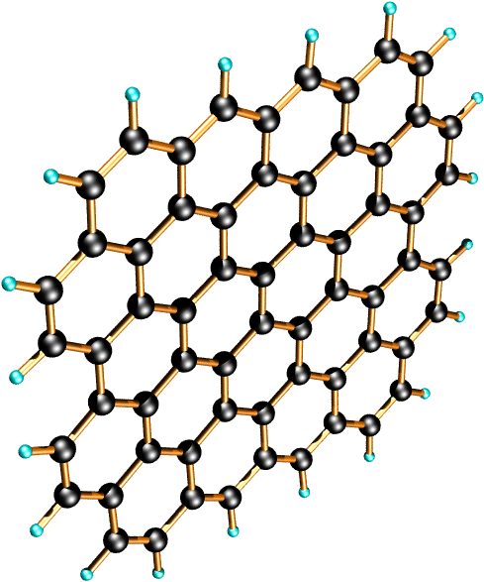
Graphene: A Honeycomb Lattice
Picture modified from: http://www.ewels.info/img/science/graphite © Dr. Chris Ewels

Slide 3
Graphene: A Honeycomb Lattice
A atom
B atom
Graphene has two atoms per unit cell.
These two atoms for two interlocking triangular sub-lattices.

Slide 4
Graphene: A Honeycomb Lattice
A atom
B atom
Graphene has two simple edge geometies.
The zigzag termination involves only one sub-lattice site.
The armchair termination involves both sub-lattice sites.
ARMCHAIR
ZIGZAG

Slide 5
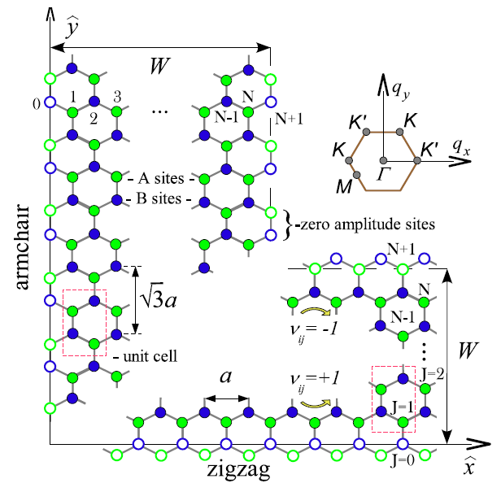
Graphene Edges and Ribbons
Take the ribbon length as infinite. Applying Bloch’s theorem gives Bloch plane-waves in that direction.
Can treat the problem on a semi-infinite sheet. Analytics must apply the appropriate boundary conditions to the total wavefunction along the edge.
Using a tight binding model, numerics of ribbons are constructed from rectangular unit cells with four atoms tiling the width.
zigzag edge
armchair edge
From review article: A.K. Geim and K.S. Novoselov, Nature Materials (2007), preprint cond-mat/0702595.

Slide 6
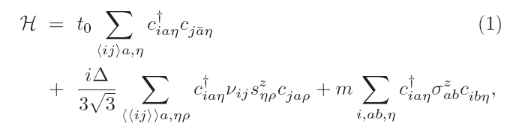
Nearest Neighbor Tight Binding Model (NN TBM)
Spin Pauli matrix
Gap inducing terms
The nearest neighbor hopping: t₀ = - 2.7 eV
The intrinsic spin-orbit coupling: Δ
An onsite sub-lattice potential difference: m
Neglect conventional spin-independent NNN hopping.
Where ν_{ij} is +1( -1) for carriers that make a LH(RH) turn as j -> i.
A/B pseudospin
Pauli matrix
Introduced by: F.D.M. Haldane, PRL 61, 2015 (1988).
Popularized by: C.L. Kane and E.J. Mele, PRL 95, 226801 (2005)

Slide 7

Zigzag Edge States: m
ZIGZAG: 38 unit cells @ 18 nm
Δ = 0.0 eV
m = 0.5 eV
Dispersionless edge states. Graphene ribbon is semiconductor.

Slide 8
Zigzag Edge States: Δ
ZIGZAG: 38 unit cells @ 18 nm
Δ = 0.5 eV
m = 0.0 eV
Current carrying edge states in the gap. They go far from K points.
QSHE: C.L. Kane and E.J. Mele, PRL 95, 226801 (2005)

Slide 9
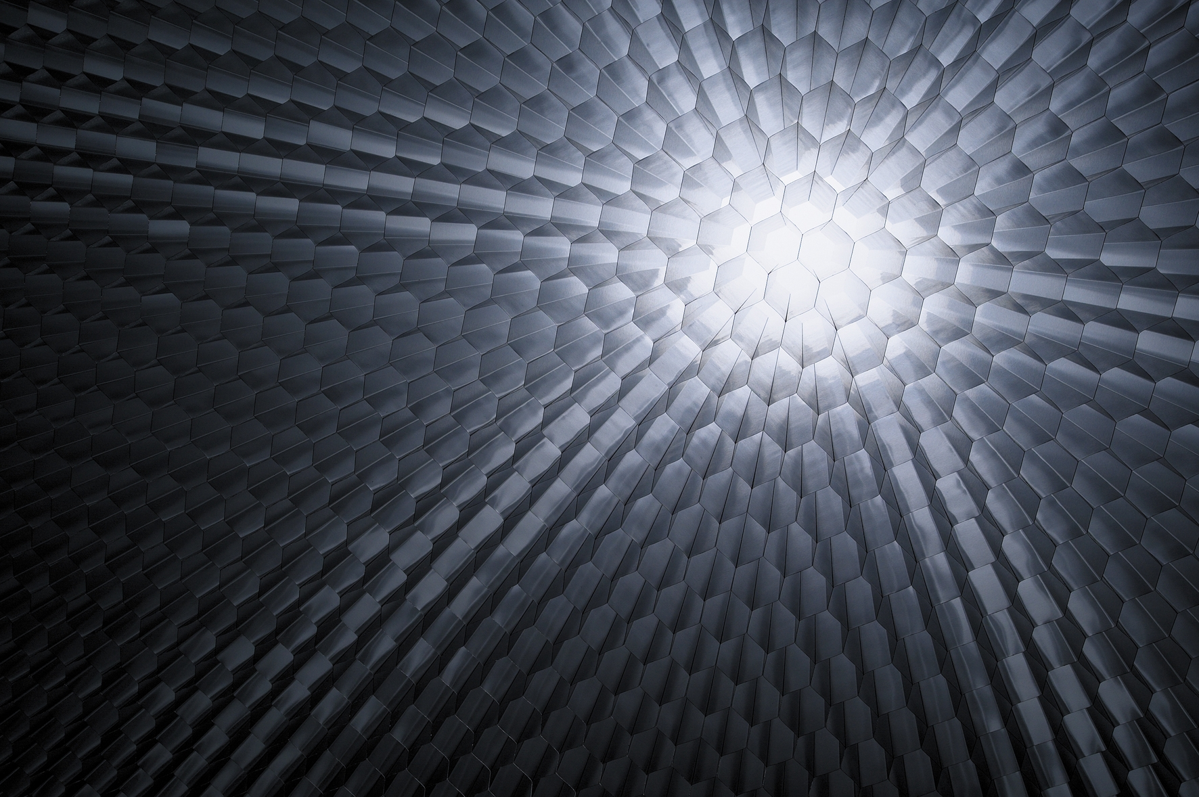
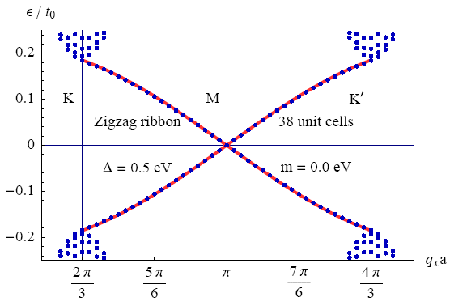
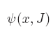
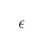
Zigzag Edge States: Δ and m
ZIGZAG: 38 unit cells ≈ 18 nm
Δ = 0.5 eV
m = 0.0 eV
Discrete y-coordinate
Ansatz:
Use the discrete TBM Schrödinger eqn. to solve the semi-infinite problem.
Dispersion (Δ, m << t₀) for spin-up right movers:
= 0.00 eV
= 0.25 eV
= 0.50 eV
where p_{x}a is measured from π.

Slide 10
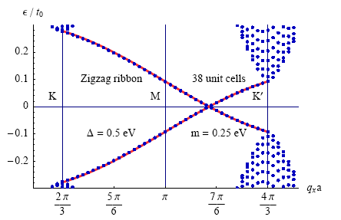
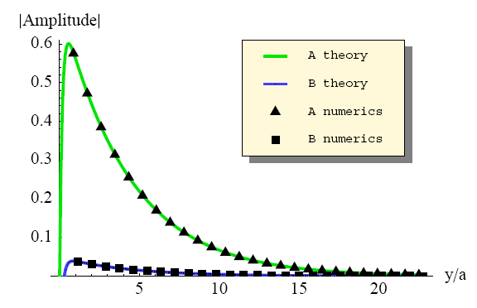
Zigzag Edge States: Δ and m
ZIGZAG: 38 unit cells ≈ 18 nm
Δ = 0.5 eV
m = 0.5 eV
Discrete y-coordinate
Ansatz:
Use the discrete TBM Schrödinger eqn. to solve the semi-infinite problem.
Dispersion (Δ, m << t₀) for spin-up right movers:
= 0.5 eV
m= 0.5 eV
where p_{x}a is measured from π.

Slide 11
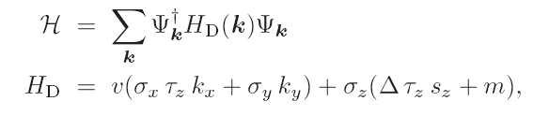
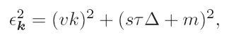
2D Dirac Equation
At low energy the TBM is effectively described by a “massive” continuum 2D Dirac model:
8-spinor
With the dispersion of the bulk bands:
valley index
Where s =+(-) for spin-up(down) and τ = +(-) labels the K (K’) valleys.
The low energy armchair edge state bands are in the valleys.
So they are described well by the continuum Dirac model.

Slide 12
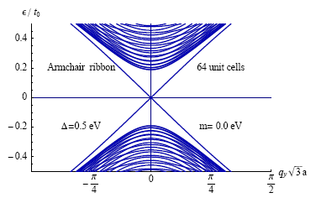
Armchair Edge States: Dirac Solution
ARMCHAIR: semi-infinite
Δ
m
The unnormalized wavefunctions:
The proper BCs for semi-infinite system
Eigenvalue problem: 8 constraints
Normalization: 2 constraints
Vanishing amplitude: 4 constraints
Vanishing current: + 2 constraints
Total real constraints 16 constraints
the dispersion of edge state bands is
where r =+1(-1) for right (left) movers;
Gap closes and no edge state solutions exist when m ≥ Δ ;

Slide 13
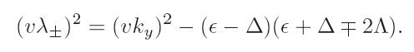
Armchair Edge States: Rashba Solution
ARMCHAIR: semi-infinite
Δ
Λ (m = 0)
Include Rashba spin-orbit coupling:
The semi-infinite dispersion is
The unnormalized wavefunctions (m=0):
Find two inverse localization lengths:
25 unit cells
40 unit cells
67 unit cells

Slide 14
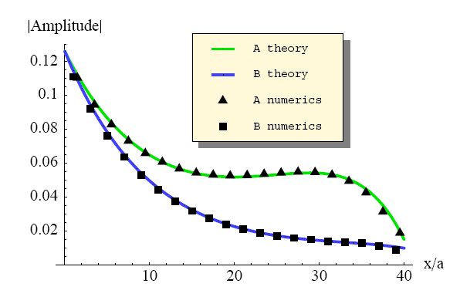
Armchair Ribbons: Rashba Solution
ARMCHAIR: 40 unit cells
Δ
Λ (m = 0)
The unnormalized wavefunctions (m = 0), where x = 0 is at the center of the ribbon:
Rashba induces a polarization near the ribbon edges that can oppose the localization at the edge due to intrinsic SO.
= 0.2 eV
Λ= 0.1 eV
Gap closes and no edge state solutions exist when Λ ≥ Δ ;

Slide 15
Conclusion
We found analytic solutions for zigzag and armchair edge geometries in the presence of spin-orbit couplings.
When armchair ribbons are expected to be topological insulators can be derived from the effective low energy theory. 2D topological insulators only have conducting edges states and have potential in quantum computing.

Slide 16
Advanced Pattern Recognition applied to Computer Vision
Dr. Sunanda Mitra
Class projects
Jason E. Hill

Slide 17
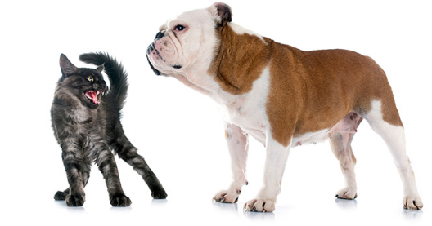
What is Computer Vision?
Goal: to mimic low level human vision tasks with computers. NOTE: not limited to the visual spectrum.
Problems:
Color spaces
Feature detection and matching
Edges and corners
Shape detectors
Scale invariance
Scene reconstruction
Image stitching (Panorama)
3D scene estimation
Segmentation/Clustering
Object Detection
Tracking
Classification?
Machine Learning
(using features)

Slide 18
I.
Homography

Slide 19
Image Alignment
How do we align two images automatically?
Two broad approaches:
Feature-based alignment
Find a few matching features in both images
compute alignment
Direct (pixel-based) alignment
Search for alignment where most pixels agree
brute force

Slide 20
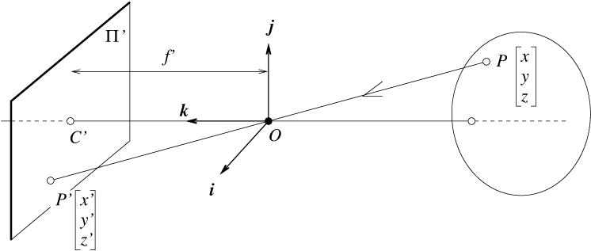
Perspective projection
camera
world
f
y
z
y’
Cartesian coordinates:
By similar triangles: (x, y, z) → ( f x/z, f y/z, -f )
The image coordinates are then

Slide 21
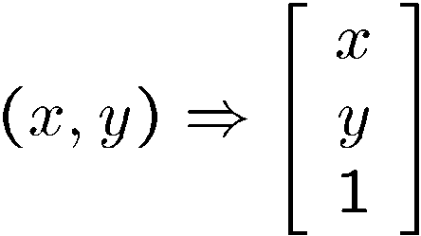
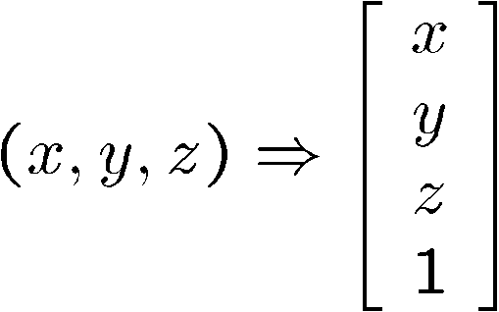
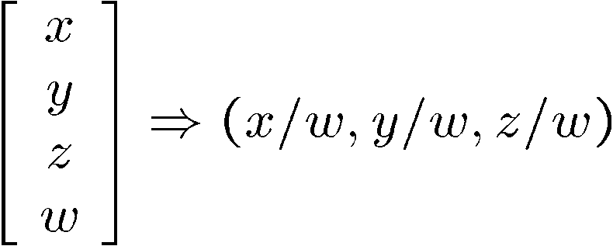
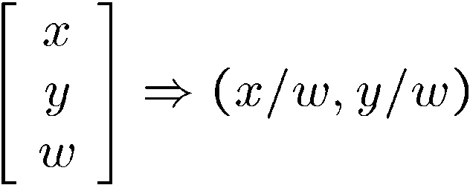
Homogeneous coordinates
Is this a linear transformation?
Trick: add one more coordinate:
no—division by z is nonlinear
homogeneous image
coordinates
homogeneous scene
coordinates
Converting from homogeneous coordinates
Slide by Steve Seitz

Slide 22
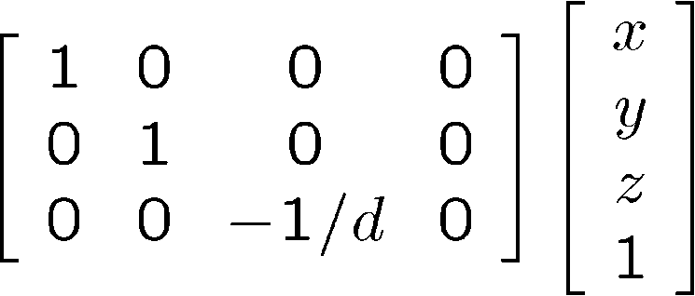
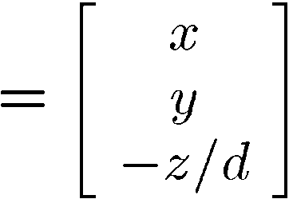
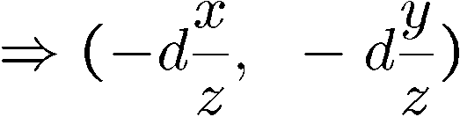
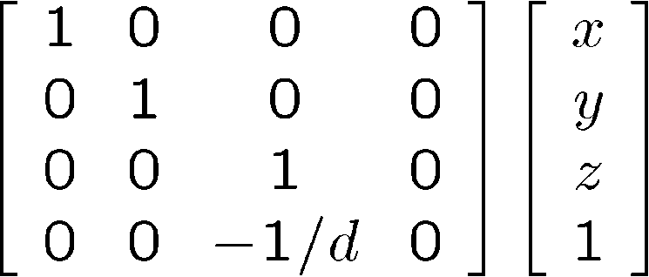
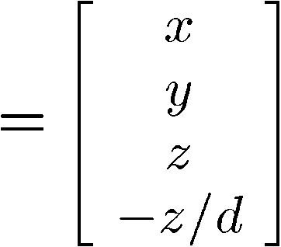
Perspective Projection
A projection is realized by multiplying a matrix with the homogeneous coordinates:
divide by third coordinate
This is known as perspective projection (PP)
The matrix is the projection matrix
Can formulate generically as a 4x4 matrix
divide by fourth coordinate
Source: Steve Seitz

Slide 23
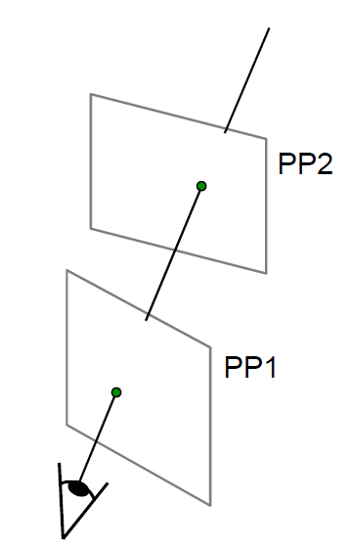
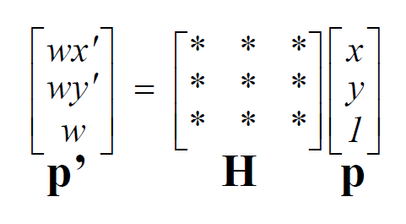
Image reprojection: Homography
A projective transform is a mapping between any two PPs
with the same center of projection
called Homography
Source: Alyosha Efros
Notes:
23

Slide 24
Estimating an homographic transformation
H
Slide from Silvio Savarese

Slide 25
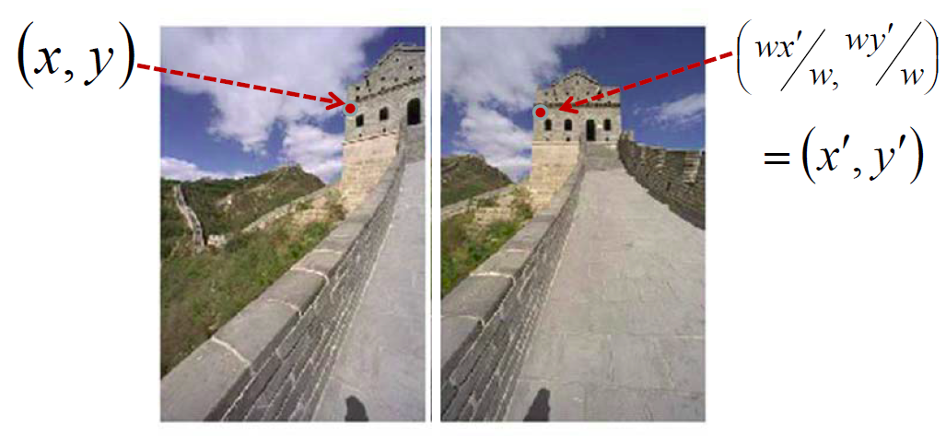
Image reprojection: Homography
To apply a given homography H
• Compute p’ = Hp (regular matrix multiply)
• Convert p’ from homogeneous to image coordinates
Notes:
25

Slide 26
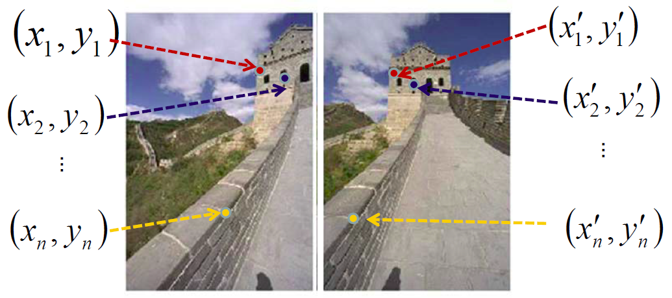
Image reprojection: Homography
Given pairs of corresponding points in the images, can solve
for the parameters of the homography matrix H. MATLAB: H = ((X*(Y.'))/(Y*(Y.'))).';
where Xest = (Y(:,i).')*H;
or from F = estimateFundamentalMatrix(X,Y)
Notes:
26

Slide 27
Scale Invariant Feature Detectors
scale
Harris-Laplacian¹ Find local maximum of:
Harris corner detector in space (image coordinates)
Laplacian in scale
← Laplacian →
y
← Harris →
x
SIFT (Lowe)² Find local maximum of:
Difference of Gaussians in space and scale
scale
← DoG →
y
← DoG →
x
¹ K.Mikolajczyk, C.Schmid. “Indexing Based on Scale Invariant Interest Points”. ICCV 2001 ² D.Lowe. “Distinctive Image Features from Scale-Invariant Keypoints”. Accepted to IJCV 2004

Slide 28
Critical issues: outliers
H
Slide from Silvio Savarese

Slide 29
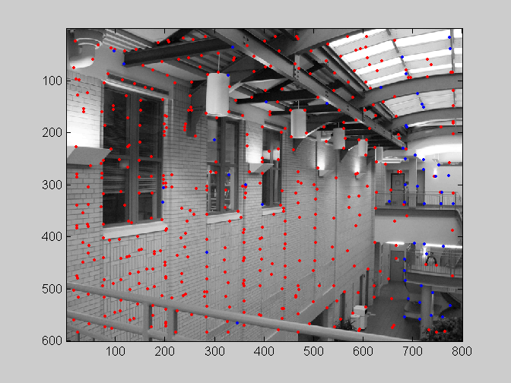
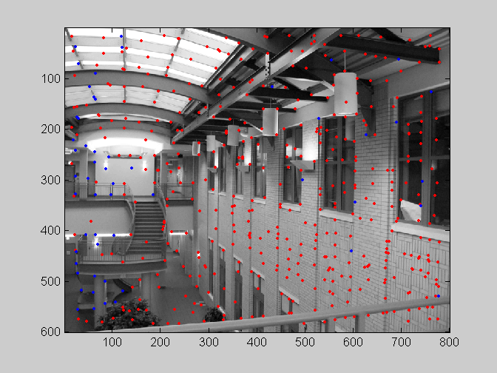
Feature-space outliner rejection
Can we now compute H from the blue points?
No! Still too many outliers…
What can we do?

Slide 30
II.
RANSAC

Slide 31
RANSAC
_{(RANdom SAmple Consensus) :}
_{Learning technique to estimate}
parameters of a model by random
_{sampling of observed data}
Fischler & Bolles in ‘81.
Algorithm:
Sample (randomly) the number of points required to fit the model
Solve for model parameters using samples
Score by the fraction of inliers within a preset threshold of the model
Repeat 1-3 until the best model is found with high confidence
Notes:
Let me give you an intuition of what is going on. Suppose we have the standard line fitting problem in presence of outliers.
We can formulate this problem as follows: want to find the best partition of points in inlier set and outlier set such that…
The objective consists of adjusting the parameters of a model function so as to best fit a data set.
"best" is defined by a function f that needs to be minimized.
Such that the best parameter of fitting the line give rise to a residual error lower that delta
as when the sum, S, of squared residuals

Slide 32
RANSAC
(RANdom SAmple Consensus) :
Line fitting example
Algorithm:
Sample (randomly) the number of points required to fit the model (#=2)
Solve for model parameters using samples
Score by the fraction of inliers within a preset threshold of the model
Repeat 1-3 until the best model is found with high confidence
Illustration by Savarese
Notes:
Let me give you an intuition of what is going on. Suppose we have the standard line fitting problem in presence of outliers.
We can formulate this problem as follows: want to find the best partition of points in inlier set and outlier set such that…
The objective consists of adjusting the parameters of a model function so as to best fit a data set.
"best" is defined by a function f that needs to be minimized.
Such that the best parameter of fitting the line give rise to a residual error lower that delta
as when the sum, S, of squared residuals

Slide 33
RANSAC
(RANdom SAmple Consensus) :
Line fitting example
Algorithm:
Sample (randomly) the number of points required to fit the model (#=2)
Solve for model parameters using samples
Score by the fraction of inliers within a preset threshold of the model
Repeat 1-3 until the best model is found with high confidence
Notes:
Let me give you an intuition of what is going on. Suppose we have the standard line fitting problem in presence of outliers.
We can formulate this problem as follows: want to find the best partition of points in inlier set and outlier set such that…
The objective consists of adjusting the parameters of a model function so as to best fit a data set.
"best" is defined by a function f that needs to be minimized.
Such that the best parameter of fitting the line give rise to a residual error lower that delta
as when the sum, S, of squared residuals

Slide 34
RANSAC
(RANdom SAmple Consensus) :
Line fitting example
Algorithm:
Sample (randomly) the number of points required to fit the model (#=2)
Solve for model parameters using samples
Score by the fraction of inliers within a preset threshold of the model
Repeat 1-3 until the best model is found with high confidence
Notes:
Let me give you an intuition of what is going on. Suppose we have the standard line fitting problem in presence of outliers.
We can formulate this problem as follows: want to find the best partition of points in inlier set and outlier set such that…
The objective consists of adjusting the parameters of a model function so as to best fit a data set.
"best" is defined by a function f that needs to be minimized.
Such that the best parameter of fitting the line give rise to a residual error lower that delta
as when the sum, S, of squared residuals

Slide 35
RANSAC
(RANdom SAmple Consensus) :
I - inliers
O - outliers
Model parameters
such that:
Source: Savarese
Notes:
Let me give you an intuition of what is going on. Suppose we have the standard line fitting problem in presence of outliers.
We can formulate this problem as follows: want to find the best partition of points in inlier set and outlier set such that…
The objective consists of adjusting the parameters of a model function so as to best fit a data set.
"best" is defined by a function f that needs to be minimized.
Such that the best parameter of fitting the line give rise to a residual error lower that delta
as when the sum, S, of squared residuals

Slide 36
RANSAC conclusions
Good
Robust to outliers
Applicable for larger number of parameters than Hough transform
Parameters are easier to choose than Hough transform
Bad
Computational time grows quickly with fraction of outliers and number of parameters
Not good for getting multiple fits
Common applications
Computing a homography (e.g., image stitching)
Estimating fundamental matrix (relating two views)

Slide 37
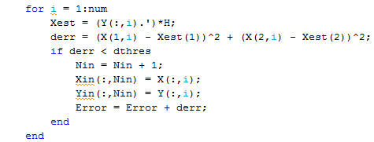
RANSAC for estimating homography
RANSAC loop:
Select four feature pairs (at random)
Compute homography H (exact)
Compute inliers where SSD( p_{i}’, H p_{i} ) < ε
Keep largest set of inliers
Re-compute least-squares H estimate on all of the inliers

Slide 38
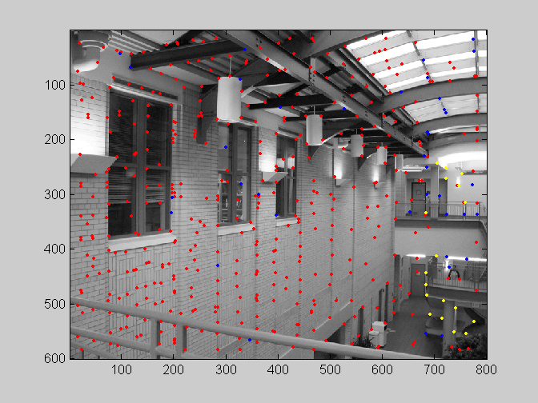
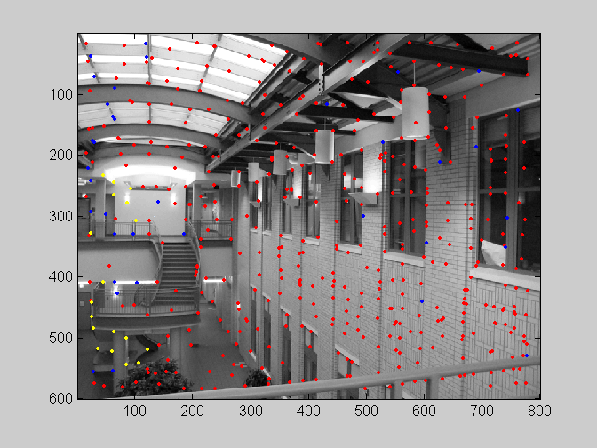
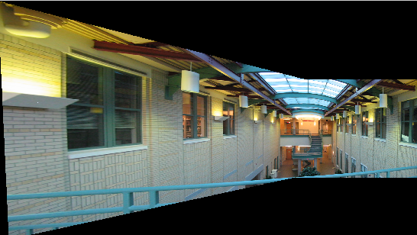
RANSAC applied to image stitching

Slide 39
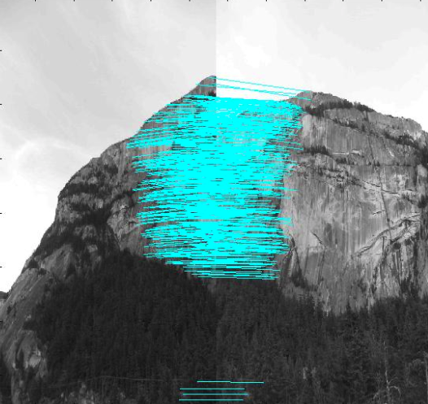
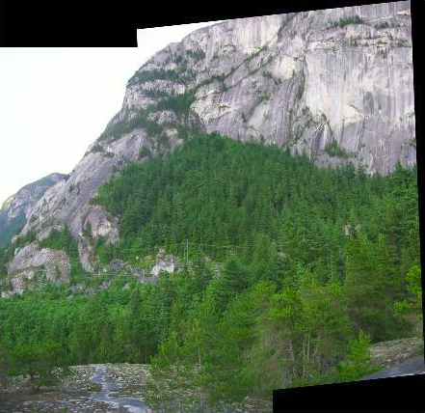

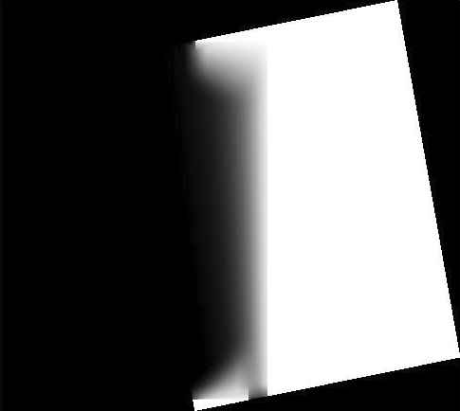
Image stitching

Slide 40
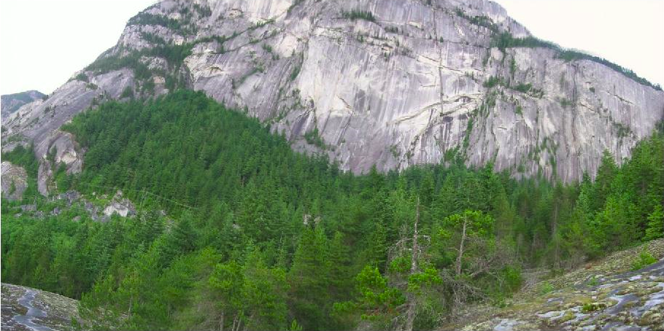
Image stitching from multiple images

Slide 41
II.
Fundamental Matrix

Slide 42
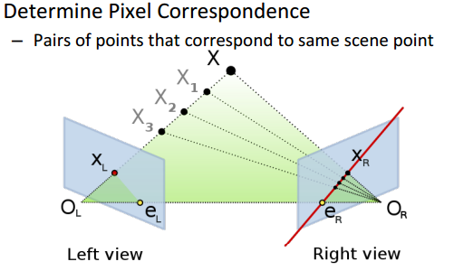
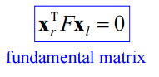
The Fundamental Matrix
Source: Richard Szeliski, Computer Vision: Algorithms and Applications, Springer, Ch. 11: Epipolar Geometry (September 3, 2010).

Slide 43
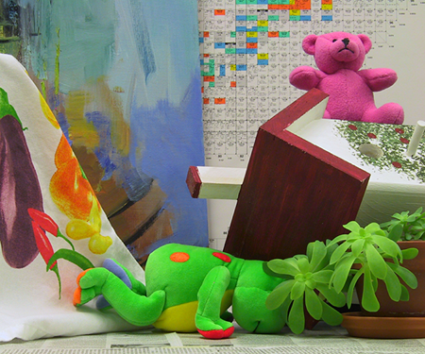
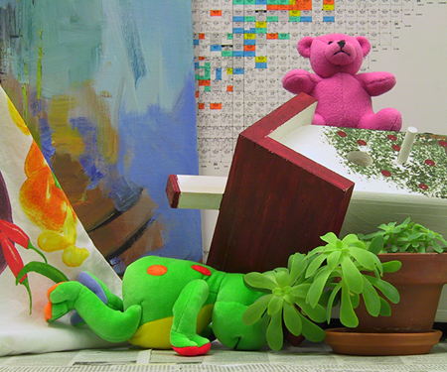
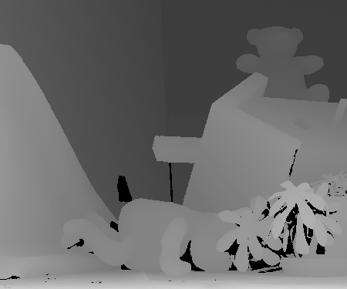
Stereo Matching unto 3D scene reconstruction
Left 2D Image
Right 2D Image
Disparity Map

Slide 44
IV.
Classifiers

Slide 45
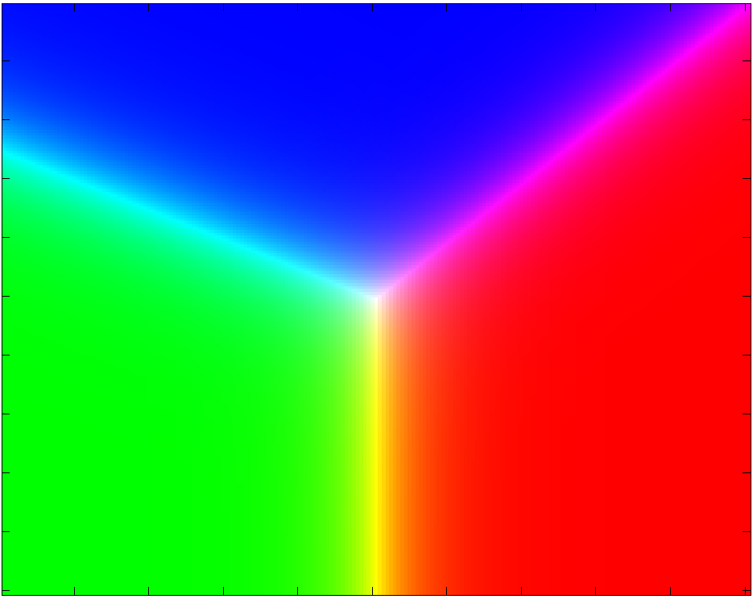
Geometry of Linear classification
Multi-class discriminative models:
Perceptron k-class logistic regression k-class SVM
Can be extended to the non-linear case with the “kernel trick”.
Source: Simon Lacoste-Julien, Multi-Class and Structured Classification, Machine Learning Workshop (Friday August 24, 2007).

Slide 46
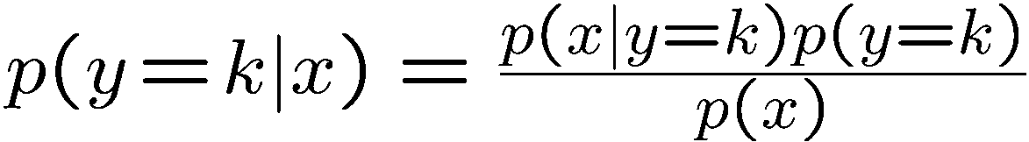
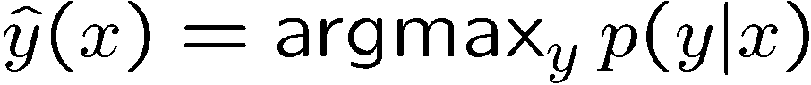
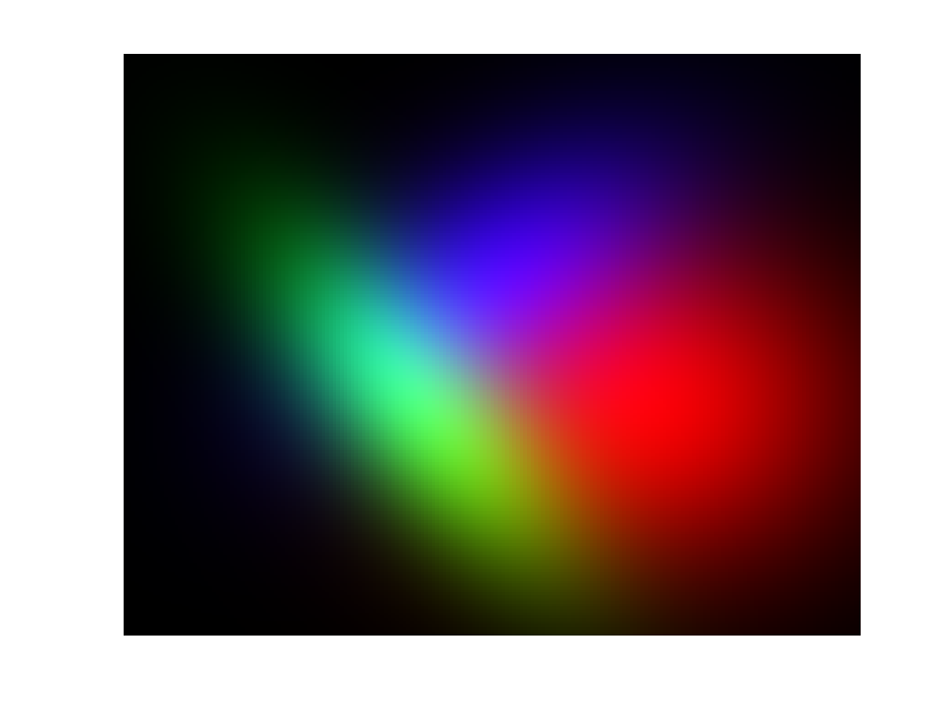
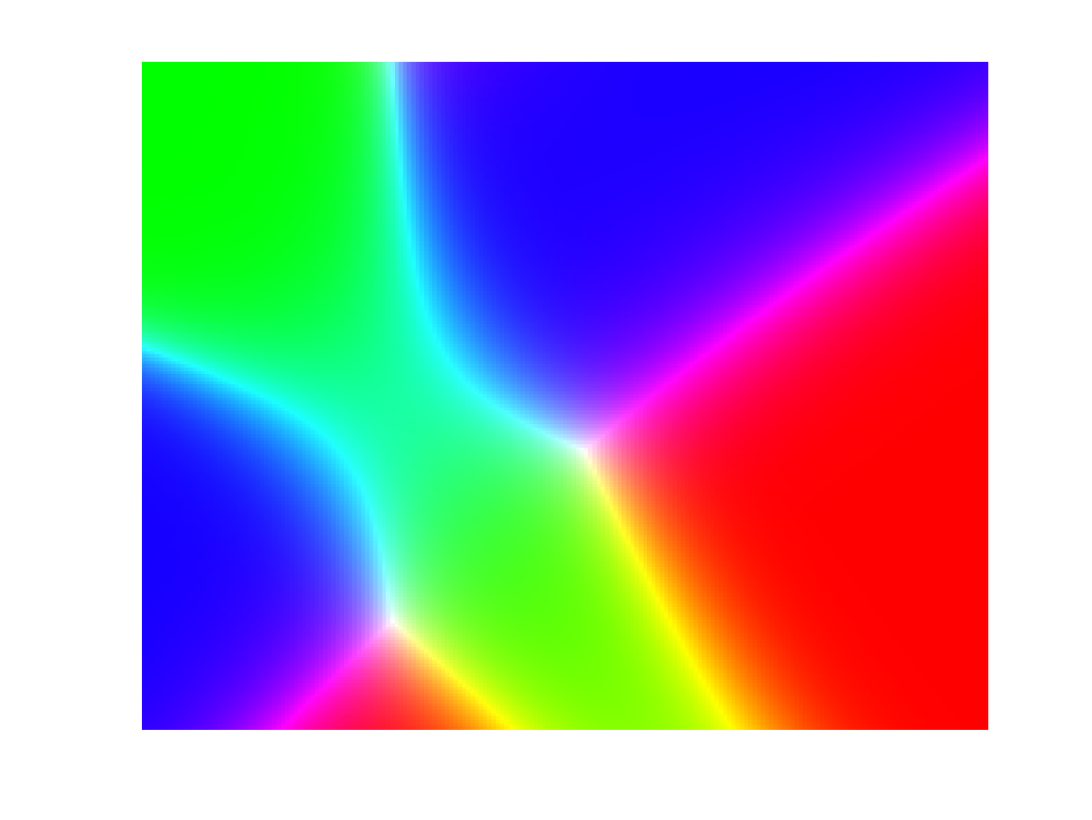
Generative models
Generalize from the binary case:
Learn p(y) and p(y|x)
Use Bayes rule:
Classify as
p(y)
p(x|y)
p(y|x)

Slide 47
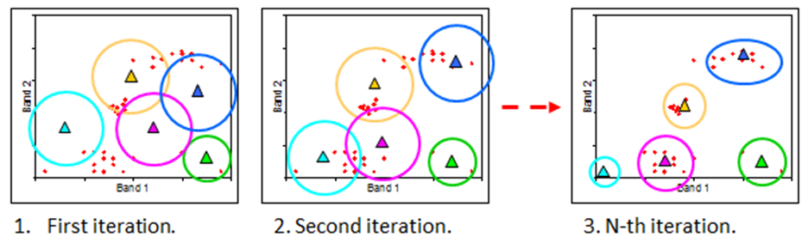
k-means and ISODATA classification
The unsupervised k-means algorithm with K = 5.
The problems with k-means is that it can get “struck” in non-ideal solutions. This is usually handled by taking the most stable result over multiple runs. The Iterative Self-Organizing Data Analysis Technique Algorithm (ISODATA) algorithm extends k-means by allowing the number of clusters to dynamically change, by merging and splitting clusters based on allowed cluster size imbalances.

Slide 48
V.
ICA & PCA

Slide 49

Denoising with FastICA

Slide 50





Dimensionality reduction with PCA
Multispectral images of Washington D.C.
IR band
R band
G band
B band
pseudocolor image

Slide 51
Optic disc boundary segmentation from diffeomorphic demons registration of monocular fundus image sequences vs. 3-D visualization of stereo fundus image pairs for automated early stage glaucoma assessment
Vijay Gatti, Jason Hill, Sunanda Mitra and Brian Nutter
Department of Electrical and Computer Engineering, Texas Tech University

Slide 52

Focus
Automatic assessment of Glaucoma using Fundus images.
Segmenting the cup and optic disc (OD) regions.
Measurement of CDR (cup to disc diameter ratio) and CAR (cup to disc area ratio) values.
Joshi, G. D., Jayanthi Sivaswamy and Krishnadas, S. R., "Depth discontinuity-based cup segmentation from multi-view colour retinal images,“
IEEE Transactions on Biomedical Engineering 59(6), 1523-1531 (2012).
Corona, E., Mitra, S., Wilson, M., Krile, T., Kwon, Y. H. and Soliz, P., "Digital stereo image analyzer for generating automated 3-d measures of optic disc deformation In glaucoma," IEEE transactions on medical imaging 21(10), 1244-1253 (2002).

Slide 53



Diffeomorphic registration of preprocessed retinal image pair
Preprocessing: An gray scale mapping is performed on the color image such that the projection distances in the color space are minimized, retaining info.
Outliers are removed with a ordered filter (a kind of generalized median filter).
Target image
Moving image
Registered image

Slide 54
Stereo Rectification
Correction for vertical and rotational shift.
Fourier based method
Vertical Shift: Phase correlation Method
Rotational Shift: Fourier rotation method
Result: Stereo pair with only horizontal shift between corresponding regions
Lusk, J. A. and Nutter, B., "Automated 3D-Reconstruction of Stereo Fundus Images via Camera Calibration and Image Rectification," 22nd IEEE
International Symposium on Computer-Based Medical Systems 1(7), 2-5 (2009).
Sonka, M., Hlavac, V., Boyle, R., “Image Processing, Analysis, and Machine Vision,” Thomson Learning, (2008).

Slide 55
Disparity Map Estimation
Region based disparity estimation
ZNCC based template matching of regions between the stereo pair.
Window size follow a pyramid structure by reducing window size to half.
Window size used: 64×64, 32×32, 16×16, 8×8 Pixels
Corona, E., Mitra, S., Wilson, M., Krile, T., Kwon, Y. H. and Soliz, P., "Digital stereo image analyzer for generating automated 3-d measures of optic disc
deformation in glaucoma," IEEE transactions on medical imaging 21(10), 1244-1253 (2002).
Sun, C., “A Fast Stereo Matching Method,” Digital Image Computing: Techniques and Applications, 95-100 (1997).

Slide 56





Disparity Map
64×64
32×32
16×16
8×8
Cubic Interpolation

Slide 57








Segmentation Results
Patient I:
Year: 1987
Year: 1998
3D
Additive
Compositive
Diffeomorphic

Slide 58


CDR and CAR

Slide 59
Conclusion
Our preliminary results show that the automated computation of CDR and CAR from composite diffeomorphic segmentation of monocular image sequences yield values comparable with those from the two established techniques.
This method may provide a framework to develop an application unto global healthcare with a cost-effective yet accurate tool for management of glaucoma in its early stage in resource poor-regions.

Slide 60
Information Theoretic Approach via IJM to Segmenting MR Images with MS Lesions Presentation by Jason E. Hill
AN INFORMATION THEORETIC APPROACH VIA IJM TO SEGMENTING MR IMAGES WITH MS LESIONS
Presentation by
Dr. Jason E. Hill
Co-authors
Dr. Brian Nutter (TTU)
Dr. Sunanda Mitra (TTU.)

Slide 61
Information Theoretic Approach via IJM to Segmenting MR Images with MS Lesions Presentation Outline
Problem Description
The “Jump” Method
The Improved Jump Method (IJM)
Validation with normal MR Brain Images
Application to MR Images with MS Lesions
Automated Segmentation of MS Lesions
Conclusions and Future Work

Slide 62
Information Theoretic Approach via IJM to Segmenting MR Images with MS Lesions Problem Description
Problem: Automated segmentation of medical images where the number of segments may be unknown a priori, due to the presence or absence of pathological anomalies. E.g. multiple sclerosis (MS) lesions.
Approach: The “Jump” Method based upon a simple information theoretic approach. This has been developed further as the Improved “Jump” Method.
Validation: the segmentation of normal MR brain images are compared with labeled MRI datasets that serve as benchmarks for any segmentation algorithm.

Slide 63
Information Theoretic Approach via IJM to Segmenting MR Images with MS Lesions Problem Description: Review of Information Theory Approach
A simple information theoretic method
(Sugar and James, 2003)
Distortion → measure of within cluster dispersion
Minimum achievable distortion associated with K centers can be defined by a Mahalanobis distance:
The k-means clustering algorithm can be used to estimate d_{K} ; since Σ is unknown it is assumed to be the identity.
The d_{K} values for K = 1,…, K_{max} can be viewed as an approximation to the distortion curve, but they are not the same. Need a power transform -Y.
p : the dimensionality of the data
x : p-dimensional random variable, the feature.
Σ : p-dimensional covariance matrix for each mixture component
c_{k} : the centroid point of the k^{th} cluster

Slide 64
Information Theoretic Approach via IJM to Segmenting MR Images with MS Lesions The “Jump” Method
The number of clusters where the largest jump occurs estimates of the number of clusters in the dataset.
The “Jump” Method
linearized distortion curve
d_{K}^{-Y}
jump operator:
J_{K}^{Y} = d_{K}^{-Y} – d_{K-1}^{-Y}
→ K* = 6
k-means → d_{K}
d_{K} → d_{K}^{-Y}
K* = 6
Y ≈ p/2

Slide 65
Information Theoretic Approach via IJM to Segmenting MR Images with MS Lesions The Improved Jump Method (IJM)
H
The Improved Jump Method (IJM) - Definitions
Effective Dimension: allowing p_{eff} to be a real number; Y = p_{eff}/2
Margin Operator:
The higher the margin, the
better the configuration is with
respect to the rest. Hence,
the margin measures the
quality of the configuration.
Only margin values
greater than 1 represent
valid jump peaks
(Corona, 2012).

Slide 66
Application of the Improved Jump Method to Medical Image Processing The Improved Jump Method (IJM): Methodology
Spectral Clustering: For a suitable σ of the Gaussian kernel, the points in the same cluster are made collinear in the score space (line passes thru the origin).

Slide 67
Application of the Improved Jump Method to Medical Image Processing The Improved Jump Method (IJM): Methodology
Projecting all points onto a unit circle, use spherical k-means (Dhillon et al., 2001) to compute the required values in order to build the d_{K} curve (Corona, 2012).

Slide 68
Information Theoretic Approach via IJM to Segmenting MR Images with MS Lesions The Improved Jump Method (IJM)
H
Image Segmentation Technique
The image color levels are quantized to only N_{q} levels using the criteria of minimum variance.
The color-quantized image is subdivided into windows centered at each pixel, and a normalized histogram is computed for each window.
A chi-squared score can then be used to compare the pixels as computed from these histograms (Fowlkes et al. 2004). The chi-squared score is defined as
where h_{i} and h_{j} are histograms for the windows located on the i^{th} and j^{th} pixels, and h_{i}(k) indicates the repetition frequency of the k^{th} bin (out of N_{q} bins) in the corresponding histogram for the i^{th} pixel.
A chi-squared RBF kernel and its kernel matrix: k(h_{i} , h_{j}) = exp(-χ²_{ij} /σ_{χ}),
where k(h_{i} ,h_{j}) is the element in the i^{th} row and j^{th} column of the kernel matrix, and σ_{χ} is the kernel standard deviation, as determined previously from the model selection.

Slide 69

Information Theoretic Approach via IJM to Segmenting MR Images with MS Lesions Validation with MRI Brain Images
Validation of the IJM with MR Brain Images.
The segmentation results from applying the IJM algorithm, with the numbered segments being the background, the grey matter, the white matter, and the cerebrospinal fluid (CSF) going left to right (Corona, Hill et al., 2013).
1 = Background
2 = Grey Matter
3 = White Matter
4 = CSF

Slide 70
Information Theoretic Approach via IJM to Segmenting MR Images with MS Lesions Validation with MRI Brain Images
The confusion matrix for MRI segmentation using a window size of 3 pixels, N_{q} = 8, and chi-squared RBF kernel with standard deviation of σ = 1.025. The overall accuracy is 95.48% (Corona, Hill et al., 2013).
True\Predicted | Segment 1 | Segment 2 | Segment 3 | Segment 4 | Accuracy
Background | 11,234 | 0 | 0 | 0 | 100.00%
Grey matter | 4 | 6,790 | 120 | 562 | 90.82%
White matter | 0 | 508 | 8861 | 0 | 94.58%
CSF | 127 | 73 | 0 | 2560 | 92.75%

Slide 71

Information Theoretic Approach via IJM to Segmenting MR Images with MS Lesions Application to MR Images with MS Lesions – First Approach
The original MRI of brain with MS lesions after preprocessing. The expected segments are 1) the WM (red), 2) the GM (purple), 3) the CSF (cyan) and 4) the MS lesions (whitish).

Slide 72
Application of the Improved Jump Method to Medical Image Processing Application to MR Images with MS Lesions – First Approach
The IJM alone fails to correctly segment the MRI of the brain with MS lesion into the expected K = 5 segments.
Grey Matter
White Matter
CSF + MS Lesions

Slide 73
Information Theoretic Approach via IJM to Segmenting MR Images with MS Lesions Application to MR Images with MS Lesions – First Approach
The red channel histogram of the CSF + MS lesion super cluster has a gap.

Slide 74
Information Theoretic Approach via IJM to Segmenting MR Images with MS Lesions Application to MR Images with MS Lesions – First Approach
With the red threshold and parameters optimized for segmenting the 4 normal tissue types, the MS lesions can be isolated first and then superimposed on this more overall accurate segmentation as shown to the right.
CSF
MS Lesions
final segmentation

Slide 75
Information Theoretic Approach via IJM to Segmenting MR Images with MS Lesions Application to MR Images with MS Lesions – First Approach
The confusion matrix for MRI segmentation for slice 105. Most other slices have similar numbers. Across the entire volume the overall accuracy of the MS lesion detection is only 61.08%, but its overall reliability is 84.32%. .... How can this be improved?
\True Predicted | Back-ground | White Matter | Grey Matter | CSF | MS lesion
Segment 1 | 13257 | 0 | 3 | 152 | 0
Segment 2 | 0 | 8074 | 91 | 0 | 3
Segment 3 | 0 | 378 | 6062 | 14 | 8
Segment 4 | 0 | 0 | 772 | 1830 | 0
Accuracy | 100% | 95.45% | 87.5% | 91.68% | 90.18%

Slide 76

Information Theoretic Approach via IJM to Segmenting MR Images with MS Lesions Automated Segmentation of MS lesions with Contrast Transformations
The flowchart of the automated MS lesion segmentation process. Steps involving the pseudo-RGB images are highlighted cyan. The subsequent steps using the transformed pseudo-grayscale image are highlighted in light gray.

Slide 77

Information Theoretic Approach via IJM to Segmenting MR Images with MS Lesions Automated Segmentation of MS lesions with Contrast Transformations
The failure of IJM alone to segment the MS lesions can be traced to the partial volumes dominating the sub-clustering process. These can be removed via a 3D edge mask.

Slide 78



Information Theoretic Approach via IJM to Segmenting MR Images with MS Lesions Automated Segmentation of MS lesions with Contrast Transformations
A particular pseudo-grayscale transformation enhances the contrast between normal and MS lesion tissue.
Statistical methods are used to determine discrete & fuzzy labels.
Color Mapped Data
Pseudo-Grayscale
Discrete labels
Fuzzy labels

Slide 79

Information Theoretic Approach via IJM to Segmenting MR Images with MS Lesions Automated Segmentation of MS lesions with Contrast Transformations
Comparison with ground truth of BrainWeb’s brain (moderate MS).

Slide 80
Information Theoretic Approach via IJM to Segmenting MR Images with MS Lesions Automated Segmentation of MS lesions with Contrast Transformations
Results for the binary discretely labeled MS lesion voxels (foreground) across the entire brain ROI of the mild, moderate and severe MS lesion brain data from BrainWeb.
 | True Positive (TP) | True Negative (TN) | False Positive (FP) | False Negative (FN) | Ground Truth (GT=TP+FP) | Sensitivity TP/GT
mild | 340 | 1954051 | 552 | 82 | 422 | 80.57%
moderate | 3383 | 1951234 | 347 | 129 | 3512 | 96.33%
severe | 9496 | 1941702 | 3375 | 608 | 10104 | 93.98%

Slide 81
Information Theoretic Approach via IJM to Segmenting MR Images with MS Lesions Automated Segmentation of MS lesions with Contrast Transformations
Comparisons measures for the discrete and fuzzy labels of MS lesion voxels across the entire brain ROI of the mild, moderate and severe MS lesion brain data.
 | Specificity TN/(TN+FP) | Reliability TP/(TP+FP) | Dice Similarity Coefficient 2TP . 2TP+FP+FN | Under Estimation FN/(TN+FN) | Over Estimation FP/(TN+FN) | Average Fuzzy SSIM
mild | 99.97% | 47.31% | 0.5175 | 0.0042% | 0.0282% | 0.9029
moderate | 99.96% | 90.70% | 0.8739 | 0.0066% | 0.0434% | 0.9468
severe | 99.83% | 73.78% | 0.8266 | 0.0313% | 0.1700% | 0.9102

Slide 82

Information Theoretic Approach via IJM to Segmenting MR Images with MS Lesions Conclusions and Future Work
Further Work
Repeat segmentation using color mapped data of clinically relevant T2-w, FLAIR and DIR images.
FLAIR offers the best SNR and is available from BrainWeb.
DIR offers the best contrast between MS lesions and White Matter, but needs to be simulated.
Validate the segmentation with various levels noise.
http://clinical-mri.com/multiple-sclerosis-visualization-of-plaques-with-differing-mr-techniques/

Slide 83
Automated Segmentation of MS Lesions in FLAIR, DIR and T2-w MR images via an Information Theoretic Approach Presentation by Jason E. Hill
Automated Segmentation of MS Lesions in FLAIR, DIR and T2-w MR images via an Information Theoretic Approach
Presentation by
Dr. Jason E. Hill
Co-authors
Mr. Kevin Matlock (TTU)
Dr. Brian Nutter (TTU)
Dr. Sunanda Mitra (TTU.)

Slide 84
Automated Segmentation of MS Lesions in FLAIR, DIR and T2-w MR images via an Information Theoretic Approach Presentation Outline
Introduction
Approach
Methodology
Results
Conclusion

Slide 85
Automated Segmentation of MS Lesions in FLAIR, DIR and T2-w MR images via an Information Theoretic Approach Introduction
Problem: the automated segmentation of T2-weighted (T2-w), Fluid Attenuated Inversion Recovery (FLAIR) & Double Inversion Recovery (DIR) Magnetic Resonance Images (MRIs) with Multiple Sclerosis (MS) lesions of various severity.
Validation: the segmentation of labeled benchmark MRI datasets of brains with MS lesions.
Goal: the automated segmentation of brain MR images for detection and tracking of MS.

Slide 86

Automated Segmentation of MS Lesions in FLAIR, DIR and T2-w MR images via an Information Theoretic Approach Methodology: workflow diagram
Workflow diagram:

Slide 87

Automated Segmentation of MS Lesions in FLAIR, DIR and T2-w MR images via an Information Theoretic Approach Methodology: simulation
MRI simulation:
FLAIR (a) and T2-w (c) MRIs are obtainable from BrainWEB, and DIR (b) is a simulated signal derived from the Bloch equation.

Slide 88

Automated Segmentation of MS Lesions in FLAIR, DIR and T2-w MR images via an Information Theoretic Approach Methodology: preprocessing
Preprocessing:
12-bit data are converted to 8-bit after screening for outliers & contrast enhancement; combined into colorized images (a) with FLAIR (red), DIR (green) and T2-w (blue). To remove the affect of the PVs, the edges are suppressed (b) for the input of the segmentation process; severe MS result shown (c).

Slide 89


Automated Segmentation of MS Lesions in FLAIR, DIR and T2-w MR images via an Information Theoretic Approach Results: find tissue centroids by IJM and fuzzy labels
Determination of tissue centroids by IJM:
Table 1. IJM results for the estimated centroids for the four tissue types in the form of RBG triples across all three MS severities obtained from BrainWeb.
The Fuzzy Membership:
And d_{E} denoted the Euclidean distance between points.

Slide 90

Automated Segmentation of MS Lesions in FLAIR, DIR and T2-w MR images via an Information Theoretic Approach Results: fuzzy memberships
Resulting fuzzy memberships:
Estimated fuzzy memberships from a Euclidean distance (β = 3) of (a) the WM; (b) the GM; (c) of the CSF; (d) MS lesions.

Slide 91


Automated Segmentation of MS Lesions in FLAIR, DIR and T2-w MR images via an Information Theoretic Approach Results: discrete and fuzzy confusion labels
Segmentation results:
Table 2. Results of the discrete binary labels for all three MS lesion severities.
Table 3. Comparison measures for discrete and fuzzy results across severities.

Slide 92


Automated Segmentation of MS Lesions in FLAIR, DIR and T2-w MR images via an Information Theoretic Approach Conclusion
Segmentation of MS lesions in FLAIR, DIR & T2-w MR images without prior knowledge of the disease presence or severity is done; yielding a sensitivity of ~90-95% and a reliability of ~58-82%; consistently deems a normal brain as MS lesion-free; robustly handles noise up to ~2% of the peak amplitude of T2-w image; is extendable to higher noise levels with a 3D bilateral filter.
However …
Artificial Neuron

Slide 93
A history of Machine Learning
Perceptron algorithm (1958) early implementation of an artificial neural network (ANN).
XOR failure (1969) stopped ANN research.
Backpropagation algorithm (1974-86) revived ANNs.
Optical character readers (1982) used by the USPS.
Support Vector Machines (SVMs: 1990s) considered more theoretically sound; augmented by kernel methods.
Random Forests (2001) an ensemble of decision trees that outperforms heavily engineered approaches.
Deep architecture breakthrough (2006) unsupervised training of levels one after another; extracting abstractions.
Deep learning dominates classification challenges (2012+) of unstructured data using hierarchical features. AlphaGo.

Slide 94

What is Deep Learning?
Deep learning is a machine learning technique that automatically “learns” features to do tasks from labeled data. AKA: end-to-end learning. Fail: adversarial data.
Implementations: Recurrent Neural Networks (RNNs) for speech recognition, EEG & NLP; Convolutional Neural Networks (CNNs) & Restricted Boltzmann Machines (RBMs) for image classification and recognition.
Frameworks: H2O, neon; trained: VGGNet, AlexNet, CaffeNet, GoogLeNet.

Slide 95




Compressive Sampling in Fast Wavelet-Encoded MRI
Zheng Liu, Jason E. Hill, Brian Nutter, Sunanda Mitra
Computer Vision and Image Analysis Lab
Department of Electrical & Computer Engineering
7/10/2014

Slide 96



Outline
Overview of fast Magnetic Resonance Imaging (MRI)
Compressive sampling (CS) in MRI
Wavelet-encoded CS-MRI
Evaluation of simulation results
Preliminary Experimental Results
Conclusions
96

Slide 97

Overview of fast MRI
k-space
k-space coverage
k_{y}
k_{y}
k_{y}
k_{y}
Phase encoding
k_{x}
k_{x}
k_{x}
k_{x}
Frequency encoding
90˚
180˚
90˚
180˚
90˚
180˚
RF
G_{z}
G_{y}
G_{x}
TE
TE
TE
TR
TR
TR
Frequency encoding
Total scan time: N_{pe}TR
Phase encoding
Pulse sequences of MRI
Slice selection
97

Slide 98
Wavelet-Encoded CS-MRI
Pulse sequences of wavelet-encoded MRI
Frequency encoding
Wavelet encoding
Slice selection
180˚
180˚
180˚
α
α
α
RF
Gz
Gy
Gx
TE
TE
TE
TR
TR
TR
k_{y}
k_{y}
k_{y}
k_{x}
k_{x}
k_{x}
V_{-J}
W_{-J}
W₋₁
98
Wavelet k-space coverage

Slide 99
Design of RF pulses
Battle-Lemarie functions
Scaling function
Wavelet
Fourier transforms of scaling function and wavelet
Scaling and wavelet basis functions in time domain (b) Fourier transforms of scaling and wavelet functions.
The major reason to choose this specific basis function set is that their FTs are smooth and rapidly decay to zero as shown. This basis set provides short RF pulses with relatively precise spatial excitation profiles.
99

Slide 100



















Evaluation of simulation results
MR image reconstruction
TE/TR=25/250 ms
Image size: 256×256
Scan time: 64 s/slice
Shepp-Logan phantom
brain MR image 1
brain MR image 2
WE-CS MRI
FE-CS MRI
46 samples 91 samples 136 samples
12 s/slice 23 s/slice 34 s/slice
46 samples 91 samples 136 samples
12 s/slice 23 s/slice 34 s/slice
100

Slide 101

Preliminary experimental results
Wavelet pulses generated by Dr. Steve Wright’s group
101

Slide 102

Preliminary experimental results
Pulse sequence generated by Dr. Steve Wright’s group (W1 RF pulse shown)
Wavelet encoding
Frequency encoding
Parameters:
TR = 2000 ms, TE = 30ms, 128mm x 128mm FOV, transverse, 2mm thick slice, 90 pulse duration = 1978 µs.
RX gain = 8 dB; Dummy scans = 4, 256 x 0 matrix.
102

Slide 103

Preliminary experimental results
Reference data: normal FT of phantom
103

Slide 104

Preliminary experimental results
Wavelet datasets:
104

Slide 105

Preliminary experimental results
Reconstructed image:
105

Slide 106

Presenting STANCE Presentation by Jason E. Hill
Presenting STANCE
Presentation by
Dr. Jason E. Hill
Co-investigators
Dr. Sunanda Mitra
Dr. Brian Nutter
Xiangyu Liu
Oliver Xie

Slide 107
Presenting STANCE Presentation by Jason E. Hill
Here we present the functional magnetic resonance imaging (fMRI) simulator STANCE, the Spontaneous and Task-related Activation of Neuronally Correlated Events simulator.
We aim to develop this into a fully functioning MATLAB toolbox with command-line functions, that can be used to generate realistic synthetic fMRI data with MATLAB scripts.
Currently, STANCE can generate data-driven synthetic neuronal activation “ground-truth”, to which motion, physiological and system noise can be added.
Ultimately STANCE will also model correlated time-series of activations and group studies. Applications: educational and statistical/analysis benchmarking … even fMRI challenge?

Slide 108
Presenting STANCE Presentation Outline
Motivation
Implementation 3D
Implementation 4D
Example results
Conclusion

Slide 109




Presenting STANCE Motivation: the fMRI BOLD signal
The contrast in MR images arises from how spin magnetization evolves in an applied magnetic field:
since different tissues have different T₁ (longitudinal) and T₂ (transversal) relaxation times.
The blood oxygenation level dependent (BOLD) signal arises from astrocytes demanding more oxygen from the capillaries, which in turn swell.

Slide 110
Presenting STANCE Motivation: Our goal
The complex nature of fMRI data generation and acquisition challenges true estimation and interpretation, despite the use of various statistical data analysis methodologies.
The goal of developing the STANCE simulator is to generate “real-enough” 4D BOLD signals given the experimental paradigm via digital phantoms. System and physiological noise as well as motion are to be generated to serve as a reference for fMRI confounds.
Sources: Denis Le Bihan, “The 'wet mind': water and functional neuroimaging,” Phys. in Med. and Biol. 52(7), (2007).
Yi Wang and Tian Liu, “Quantitative Susceptibility Mapping (QSM): Decoding MRI Data for a Tissue Magnetic Biomarker,” Magn. Reson. in Med. 73(1), (2015).
M. Welvaert and Y. Rosseel, “A review of fMRI simulation studies,” PLoS ONE 9(7), e101953 (2014).

Slide 111



Presenting STANCE Implementation 3D: Select subject
Select a subject – the one of the 20 available brains (10 male, 10 female) as provided by BrainWEB’s 20 normal anatomical brain phantoms.
Each brain phantom has an anatomical T1-weighted volume and fuzzy membership volumes for 12 different tissues types.
Aubert-Broche, B., Griffin, M., Pike, G.B., Evans, A.C. & Collins, D.L. (Nov. 2006) “Twenty New Digital Brain Phantoms for Creation of Validation Image Data Bases,” IEEE Transactions on Medical Imaging 25(11) pp. 1410–1416.

Slide 112



Presenting STANCE Implementation 3D: Register MNI152 to native
Register MNI152 brain to native space
Subject’s native space has a voxel size of 1mm³ with dimensions 181x217x181
T1-w data &12 fuzzy tissue membership volumes from one of 20 brain phantoms; average PD, T₁ & T₂* values for various tissues
Register
Affine transform of MNI152 to subject’s native space
MNI152 brain

Slide 113



Presenting STANCE Implementation 3D: Create baseline volumes
Construct PD, T₁ & T₂* volumes
Generate functional space (fMRI scan)
Gray matter priors in functional space
Rotated by tilt angle.
Resize voxels and reslice volume with slice gap
and new dimensions.

Slide 114



Presenting STANCE Implementation 3D: model the activation map
Define activation regions from data/ shapes; Gaussian mask in MNI space
Transform & reslice activations to functional space; mask with gray matter

Slide 115



Presenting STANCE Implementation 3D: model the BOLD response
Construct T₂* volume with activation

Slide 116


Presenting STANCE Implementation 3D: calculate the MRI signal
Solve EPI signal equation
$$S=K∙PD\frac{\sin{α}\left(1−e^{−{TR}/{T1}}\right)}{\left(1−\cos{α}e^{−{TR}/{T1}}\right)}e^{−{TE}/{{T2}^{∗}}}$$
Left: Pristine EPI signal; Right: difference between EPI signal and that with no activation.

Slide 117


Presenting STANCE Implementation 3D: noisy data
Add noise, attenuation, motion, etc.
OUTPUT:
*.nii.gz
Compressed
NIFTI file
Left: with 4% of peak system noise; Middle: difference between noisy and pristine signals; Right: an attenuated signal (λ = 8.33 mm).

Slide 118


Presenting STANCE Implementation 3D: define map from atlas
Activation maps may also be defined from atlases, such as AAL, Brodmann, Harvard-Oxford, Craddock and Brainnetome.

Slide 119

Presenting STANCE Implementation 3D: define map from data
Data derived maps from www.neurosynth.org.

Slide 120



Presenting STANCE Implementation 4D: experimental design & HRF
To generate 4D time-series the experimental design must be specified along with the hemodynamic response function (HRF) and model.
This is the sustained model of the hemodynamic response: the HRF convolved with the boxcar.

Slide 121
Presenting STANCE Implementation 4D: OSO model of response
This is the transient model of the hemodynamic response: the HRF convolved with the derivative of boxcar (specifically at the onset and offset times). Onset to Offset response ratio set to 0.5.

Slide 122


Presenting STANCE Implementation 4D: noise in fMRI signals
Temperature
and
system
Source: Thomas T. Liu, “Noise contributions to the fMRI signal: An Overview” NeuroImage (2016).

Slide 123
Presenting STANCE Implementation 4D: physiological noise sources
The vertical displacement of the chest during regular respiration is then modeled for the i^{th} cycle as
The system noise has a Rician distribution. Physiological noise in MRI signals comes from 6 sources:
The respiratory pulse (RP) follows the respiratory volume time-series (RVT) or the chest displacement time-series;
The cardiac pulse (CP) follows the pulse wave velocity (PWV);
The interaction between CP and RP (InterCRP);
The result of the respiratory response function (RRF) convolved with the RVT; i.e. how changes in respiration affect the signal.
The result of the cardiac response function (CRF) convolved with heart rate variability (HRV);
Mayer waves due to variation in arterial blood pressure (BP).

Slide 124


Presenting STANCE Implementation 4D: physiological signals
The gold standard for non-invasively measuring heart activity is by electrocardiography (ECG).
Respiration can be monitored by tracking chest displacement or the end tidal CO₂.
Pulse oximetry allows for heart rate and oxygen saturation monitoring, after removing motion. Implementations: forehead, finger, wrist.
Measures the oxygen saturation
of hemoglobin (~95-98%):
Source: Dr. Chong’s ECE 5332-003 lecture slides.

Slide 125

Presenting STANCE Implementation 4D: physiological signals
Pulse oximetry wave-forms are direct measurements of light absorbed by tissue. The cardiac signal can be measured since oxyhemoglobin and deoxyhemoglobin absorb red and infrared light differently
Heart Beat
Respiration
Source: Dr. Chong’s ECE 5332-003 lecture slides. Wave-form figure provided by SMA. Salehizadeh.

Slide 126



Presenting STANCE Implementation 4D: respiratory motion
The vertical displacement of the chest during regular respiration is then modeled for the i^{th} cycle as
The modeling of physiological noise begins with modeling the chest displacement motion due to respiration.
The vertical displacement of the chest during regular respiration is modeled for the i^{th} cycle as where φ ∈ [-0.5,+0.5] parametrizes the time/RI, relative to
the i^{th} impulse; the amplitude A_{i} is proportional to the RI with average of 1.0 cm.

Slide 127






Presenting STANCE Implementation 4D: respiratory volume, RRF
The vertical displacement of the chest during regular respiration is then modeled for the i^{th} cycle as
Next the respiratory volume and response are estimated.

Slide 128



Presenting STANCE Implementation 4D: Cardiac noise
The vertical displacement of the chest during regular respiration is then modeled for the i^{th} cycle as
The modeling of cardiac noise begins with modeling of the instantaneous heart beat rate from an Integral Pulse Frequency Modulation (IPFM) model.
Analysis of HRV data for healthy subjects in a supine position yields a set of three almost equally weighted spectral bands at (VLF) ω₁ = 0.01-0.03, (LF) ω₂ = 0.09-0.11 and (HF) ω₃ = 0.2-0.3 Hz.
The instantaneous heart rate = (1 + m(t))/T

Slide 129





Presenting STANCE Implementation 4D: Pulse wave velocity, CRF
The vertical displacement of the chest during regular respiration is then modeled for the i^{th} cycle as
Next the cardiac pulse and response are estimated.

Slide 130




Presenting STANCE Implementation 4D: variability in tissue types
The vertical displacement of the chest during regular respiration is then modeled for the i^{th} cycle as

Slide 131
Presenting STANCE Implementation 4D: add motion
The vertical displacement of the chest during regular respiration is then modeled for the i^{th} cycle as
After the addition of physiological noise, but before adding system noise, motion is added to the time-series.
6 motion parameters can be estimated from real data.
Apply rigid body motion translations and rotations according to the slice timing of the fMRI scan.
Estimate spin-history effects geometrically by the amount of the slice volume that moves off resonance.

Slide 132


Presenting STANCE Example Results: experimental boxcars
The vertical displacement of the chest during regular respiration is then modeled for the i^{th} cycle as
From Chris Rorden’s educational website use alternating L/R-handed finger tapping task experimental design boxcars:

Slide 133


Presenting STANCE Example Results: 3D activation maps
The vertical displacement of the chest during regular respiration is then modeled for the i^{th} cycle as
From NeuroSynth.org construct peak sustained neurological activation maps for finger tasks based on observed amplitudes:

Slide 134


Presenting STANCE Example Results: simulated EPI signal
The vertical displacement of the chest during regular respiration is then modeled for the i^{th} cycle as
Synthetic fMRI data can now be constructed (with spatial variability of HRF proof-of principle in demo):
Noise standard deviations fit to what is observed in real data which varies with tissue type.
(CSF dominated)
(GM dominated)

Slide 135


Presenting STANCE Example Results: simulated EPI signal + noise
The vertical displacement of the chest during regular respiration is then modeled for the i^{th} cycle as
Add physiological noise and then all noise with system also:

Slide 136

Presenting STANCE Example Results: load motion time-series
The vertical displacement of the chest during regular respiration is then modeled for the i^{th} cycle as
Load the estimated time-series of the 6 motion parameters:
Note: the y-displacement time-series is observed to be modulated by breathing.

Slide 137


Presenting STANCE Example Results: more fully simulated EPI
The vertical displacement of the chest during regular respiration is then modeled for the i^{th} cycle as
Add motion and then all noise + motion:
Note: motion is task dependent.

Slide 138


Presenting STANCE Example Results: compare with real data
The vertical displacement of the chest during regular respiration is then modeled for the i^{th} cycle as
Compare representative voxel time-series:

Slide 139


Presenting STANCE Example Results: compare with real data cont.
The vertical displacement of the chest during regular respiration is then modeled for the i^{th} cycle as
Representative voxel time-series averaged over blocks:

Slide 140
Oral Presentation SPIE Medical Imagin 2017 paper 10133-41
An automated segmentation for direct assessment of adipose tissue distribution from thoracic and abdominal Dixon-technique MRIs
Dr. Jason E. Hill, Dr. Sunanda Mitra, Ryan Hayden
Dept. of Electrical and Computer Engineering, Texas Tech University
Dr. Maria Fernandez-del-Valle
Dept. of Applied Health (Exercise Physiology), Southern Illinois University Edwardsville
Feb 14, 2017

Slide 141
Segmentation of AT from Dixon MRIs Presentation Outline
Introduction
The Dixon Technique
Methodology
Results
Conclusion

Slide 142
Segmentation of AT from Dixon MRIs Introduction: MRI/MRS as the gold standard
Quantification of fat distributions has been carried out by various medical imaging modalities (more informative than other metrics).
MRI is the preferred modality for general use in whole-body adipose tissue (AT) assessments and for longitudinal studies.
MRI and Magnetic Resonance Spectroscopy (MRS) techniques have been deemed as the gold-standard for assessing total fat content as well as regional distributions in the body.
The multi-echo Dixon technique along with breath-hold is convenient because it is fast and separately reconstructs fat- & water-only images, simplifying the segmentation process.
This is a direct measure of the signal coming from fat, but keep in mind that a fat signal is not always the same as AT.
Thomas, E. L., et al. "Whole body fat: Content and distribution," Progress Nuclear Magn. Res. Spect. 73, 56–80 (2013).

Slide 143




The Dixon Technique Water- & fat-only image reconstruction
The Dixon imaging technique uses the resonance frequency difference between water and fat (Δf ≈ 440 Hz at 3.0 T) to reconstruct the water- & fat-only components of the signal in post-processing. The in-phase (IP) and out-of-phase (OOP) images are added together with a phase unwrapping off-set to get water-only images, and subtracted to get fat-only images.
$$Water∝IP+e^{iβ}OOP$$
$$Fat∝IP−e^{iβ}OOP$$

Slide 144
Methodology Study design: An exercise intervention study
Inclusion criteria: 18–30 years old healthy female; BMI = 30–40 kg/m².
Exercise intervention: supervised circuit training in 3 sessions/week.
Subjects lay in a supine, head first position with arms extended above their head, with a triangular support pillow under the knees.
Two body coils were laid length-wise over the thoracic and abdominal regions with a small overlap prior to scanning.
Imaging was performed using a dual-echo T1-weighted spoiled 3D gradient recall echo (GRE) sequence called the Volumetric Interpolated Breath-hold Examination (VIBE) Dixon sequence on the 3T Skyra MRI system (Siemens) at the Texas Tech Neuroimaging Institute (TTNI).
Each 3D scan involved the acquisition of 120, 2.5 mm thick slices with 20% gap; matrix = 320 × 260 of square voxels (FOV = 450 mm) after interpolation; effective voxel size: 1.40625 × 1.40625 × 3.0 mm³.

Slide 145
Methodology Workflow of analysis and segmentation
Analysis methodology for this preliminary study with steps labeled as manual (light red), with specified parameters (green) and fully automatic (yellow).
Preprocessing
Fat-only and Water-only Volumes
MRI volume rectification
Anatomical key-point labeling
Inhomogeneity correction by closing
Contrast enhancement by histogram
Segmentation
Segment subcutaneous fat
Construct body cavity mask
Define the void signal within body
Construct binary body mask
Foreground threshold
(Otsu check)
Lungs?
No
Segment visceral and intermuscular fat
Yes
Segment fat around heart & aorta
Construct lung mask
Construct aorta mask
Construct heart mask

Slide 146


Methodology MRI volume rectification
Rectification was guided by the MR scanner coordinates for each scan stored in the DICOM headers. The MRI volumes from the two scans are “stitched” together by establishing the fiducial plane of the patient table.

Slide 147

Methodology Labelling of Key Anatomical Landmarks
Several key anatomically associated points and axial slices were labelled for each rectified volume. These include the center points of the aorta, the apex of the heart, key intervertebral disks (our fiducials), the umbilicus, and the femoral heads.
apex of heart
UM
(a) The sagittal slice of the water-only signal derived from the Dixon scan with anatomical landmarks labeled. (b) a 3D reconstruction of the heart organ tissue from the subsequent segmentation

Slide 148


Methodology Correct inhomogeneity & enhance contrast
(a) The raw data of the water only signal. (b) Contrast enhancement derived from sampling the body cavity mask, excluding center region to avoid the aorta. (c) Resulting normalized image after inhomogeneity correction, masking out of the background and contrast enhancement.
(a) The raw data of the water only signal.
(a) The raw data of the water only signal. (b) Contrast enhancement derived from sampling the body cavity mask, excluding center region to avoid the aorta.
UM
(a) The histogram of the inhomogeneity corrected fat-only abdominal image with low-intensity background bins removed. (b) Resulting contrast enhanced image, where the peak is taken as maximum intensity, & (c) the adjusted valley intensity value is used as an automatically determined threshold to segment the foreground fat signal from everything else, producing the AT mask.

Slide 149

Methodology Define void signal
,
In addition to the enhanced fat-only and water-only signals, it is also useful to construct a normalized “void” signal, which is defined as,
S_{void} = 2 – S_{fat} – S_{water} ,
since the maximum possible value of the sum of the normalized signals (S_{fat} + S_{water}) is 2. A simple threshold of 1.5 can be used to segment the voids (1.0 corresponds merely to a saturated fat- or water-only signal).
UM
(a) fat-only image, (b) water-only image, and (c) the constructed void “signal” highlighting the lungs

Slide 150

Methodology Construct the body cavity mask
UM
Construction of the body cavity mask: (a) the binary water-only image is eroded morphologically around the skin (using the body mask) and the remainder is closed to yield (b) which is filled and opened to yield (c) which is again closed to yield (d) which has its edges smoothed by finding the convex hulls of the colored masks
Construction of the body cavity mask: (a) the binary water-only image is eroded morphologically around the skin (using the body mask) and the remainder is closed to yield (b) which is filled and opened to yield (c) which is again closed to yield (d) which has its edges smoothed by finding the convex hulls of the colored masks and is also masked with (e) a posterior masked and opened form of (a) to finally yield (f) the body cavity mask.
Construction of the body cavity mask: (a) the binary water-only image is eroded morphologically around the skin (using the body mask) and the remainder is closed to yield (b) which is filled and opened to yield

Slide 151

Methodology Preliminary abdominal AT segmentation
UM
- subcutaneous fat
- visceral fat + other fat
- organs
- voids

Slide 152

Methodology Basic heart and heart fat segmentation
UM
(a) the result for thresholding the void image > 127 and morphologically opened to yield the preliminary binary mask (b) which is refined around the edges to yield (c) the lung mask (white),which is used along with the aorta + PAAT (pink) to frame (d) the preliminary heart mask (white), which can in turn be used to detect the heart fat by dilation of its convex hull (green), that can be further segmented as (e) the epicardial AT (EAT) & (f) the paracardial AT (PAT) masks.
(a) the result for thresholding the void image > 127 and morphologically opened to yield the preliminary binary mask
(a) the result for thresholding the void image > 127 and morphologically opened to yield the preliminary binary mask (b) which is refined around the edges to yield
(a) the result for thresholding the void image > 127 and morphologically opened to yield the preliminary binary mask (b) which is refined around the edges to yield (c) the lung mask (white),which is used along with the aorta + PAAT (pink) to frame

Slide 153

Methodology Refinements and resulting segmentation
Internal AT is then further segmented into intermuscular AT (IMAT), which is between the muscles that envelope the body cavity; and either as VAT within the abdomen proper or as thoracic adipose tissue (TAT) above the diaphragm. Use Bayesian classifier for heart tissue near the apex.
(a) Segmentation of an abdominal slice, where the organs (crimson), voids (dark blue), SAT (yellow), VAT (bright green) and IMAT (beige) are shown; (b) segmentation results of the lungs (bright blue), heart (bright red), EAT (silver), PAT (sea green), aorta (magenta) and PAAT (cyan) are shown; (c) stacked bar graph of the slice by slice changes in the PAAT (cyan), EAT (silver) and PAT (sea green) from pre- to post-intervention scans for subject B.
UM

Slide 154

Results Decrease in cardiac fat volumes observed
All but one of these adipose tissue volumes decrease after the intervention for all four subjects, with the average EAT decreasing by 14.47%, the average PAT decreasing by 8.72%, and the average PAAT decreases by 3.5% from the initial values, although inter-subject variability persists.
UM
Stacked bar graphs of the slice by slice changes in the PAAT (cyan), EAT (silver) and PAT (sea green) from pre- to post-intervention scans (a) for subject A, (b) for subject C, and (c) for subject D. Note: the EAT bars that cross the 0 line are obscuring the PAAT bar which has an opposite sign for that slice.

Slide 155
Results Tabulated results for 4 subjects
Volume Subject |  | Abdominal VAT+ [cc] | Peri-aortic AT [cc] | Epicardial AT [cc] | Paracardial AT [cc]
A | pre | 4767.33 | 36.28 | 111.90 | 77.09
 | post | 4776.52 | 34.97 | 100.45 | 66.39
 | difference | +9.19 | -2.01 | -11.44 | -10.71
B | pre | 3694.97 | 18.29 | 117.41 | 79.21
 | post | 3490.02 | 17.36 | 95.66 | 78.43
 | difference | -204.95 | -0.93 | -21.74 | -0.78
C | pre | 3454.66 | 21.75 | 79.40 | 41.35
 | post | 3449.13 | 21.82 | 74.95 | 38.96
 | difference | -5.53 | -0.60 | -4.45 | -2.38
D | pre | 5919.30 | 30.21 | 139.82 | 122.40
 | post | 5889.01 | 28.66 | 112.51 | 108.34
 | difference | -30.28 | -1.55 | -27.31 | -14.06
average (standard deviation) | pre | 4459.07 (1128.42) | 26.63 (8.15) | 112.13 (24.94) | 80.01 (33.17)
 | post | 4401.17 (1167.78) | 25.70 (7.73) | 95.89 (15.66) | 73.03 (28.76)
 | difference | -57.90 (99.38) | -0.93 (0.63) | -16.23 (10.24) | -6.98 (6.42)
UM

Slide 156

Results 3D renderings of the fat near heart
A reduction in heart fat depots is associated with better health outcomes. 3D renderings of the cardiac-related fat depots are shown below.
UM
From left to right: PAAT, EAT and PAT 3D volume renderings from pre-intervention data for subject D, where slice number counts up from the diaphragm. The slice by slice volumes displayed as stacked bars going from left to right for the aorta (magenta), PAAT (cyan), heart (red), EAT (silver) and PAT (sea green) tissues are shown in the inset, where slice numbers count down.

Slide 157
Conclusion Our contribution
We provide estimations of heart fat distributions from Dixon MRI.
Quantification of fat around the heart is feasible with fast 2-point Dixon scans having rapid TR; the Dixon-technique MRI with breath-hold offers good contrast between fat and water bearing tissue.
This could potentially act as a surrogate for other measures, e.g. from cardiac-gated CT approaches, which is useful for intervention studies.
We also illustrate lung imaging via the void signal.

Slide 158

Conclusion Further refinement
Validation by comparing with the manual segmentation of a radiologist has been accomplished (results to be published).
Rectification and alignment at the sub-millimeter level has been achieved via interpolating the fiducial intervertebral disc (IVD) locations.
IVD slice locations are labeled. There is some preliminary work to automate this process, with some partial success.
An ellipse mask is grown from the location seed in the water-only volume.
The spinal cord can be extracted.

Slide 159
THANK YOU.

Slide 164
Presenting STANCE
Supplemental Material.

Slide 165

Projective Transformations
Projective transformations …
Affine transformations (parallel lines kept), and
Projective warps
Properties of projective transformations:
Origin does not necessarily map to origin
Lines map to lines
Parallel lines do not necessarily remain parallel
Ratios are not preserved
Closed under composition
Models change of basis

Slide 166


Linear Dual (LD) Problem
K.
Duality gap: for feasible solutions.
From LP duality theory: there exists x* and ( y*, s* ) feasible for primal and dual, respectively, such that
Notes:
“maxEntropy.M” is the solution file.

Slide 167

Linear Programming (LP) Problem
K.
Here x is a vector of n variables (components), thus the problem is to minimize a dot product.
Each x_{i} ≥ 0, and the domain of x forms a closed convex cone K.
If x, w ∈ K → α x + β w ∈ K, for α, β ≥ 0. K is closed.
Can be solved exactly in polynomial time.
Notes:
“maxEntropy.M” is the solution file.

Slide 168





Semidefinite Program (SDP) Problem
Let X be an n × n symmetric matrix ( X = X ^{T} )
where the inner product of square matrices is
⟨ C, X ⟩ =
We denote that X is symmetric and positive semidefinite by and means that
Can be solved almost exactly in polynomial time.
Notes:
“maxEntropy.M” is the solution file.

Slide 169
Application of the Improved Jump Method to Medical Image Processing The “Jump” Method
K
The Major Drawbacks of the “Jump” Method
(Corona, 2012)
Because the k-means algorithm performance is extremely dependent on the choice of the initial centers, the accuracy of the distortion curve may be compromised by a poor initialization. E.g. k-means using gradient descent can get “trapped” in local optima which yields a crude estimation of d_{K} using k-means results in very noisy or inaccurate “jump” selections.
The method assumes high dimensionality (p → ∞), accurate d_{K} values, well balanced clusters, identical covariance matrix, sufficiently large distance between centroids, etc. and the power transformation can only be determined under these assumptions for underlying Gaussian distributions. Real world data easily violate these assumptions.
If strong correlations are present among variables, or if the clusters have intriguing or complicated shapes, linear algorithms such as k-means will not capture the data essence.

Slide 170
Application of the Improved Jump Method to Medical Image Processing The Improved Jump Method (IJM)
K
Improvements to the “Jump” Method
(Corona, 2012)
Spectral clustering and probabilistic initialization techniques can be used to attenuate the suboptimal convergence of the k-means algorithm.
Handling realistic data necessitates that the power transform, Y, be adaptively modified according to the data at hand. By maximizing this new objective function one obtains a suitable power transformation, Y, that ensures a more robust solution to the number of clusters in a dataset.
Find a suitable kernel method to map the original dataset onto a “better” space where the mapped data is well behaved such that the “jump” method can be used there more effectively.

Slide 171
Application of the Improved Jump Method to Medical Image Processing The Improved Jump Method (IJM): Methodology
The Improved Jump Method (IJM) – Methodology 3
Using the d_{K} information one can calculate the corresponding M*_{K} for each configuration tested.
A simple comparison among the values of M*_{K} is sufficient to determine a suitable number of clusters, and appropriate parameters for the construction of the kernel matrix (i.e. model selection).
H

Slide 172
Application of the Improved Jump Method to Medical Image Processing The Improved Jump Method (IJM): Example
By normalizing the score PCA-reduced space, the scores are projected onto the unit sphere, depending on the number of clusters searched.
Higher dimensional data spaces are projected onto the appropriate unit hyper-sphere, decreasing the dimensionality by one.
Example, K = 4, p = 3, N =400 each, with high correlation → k-means has shown poor results here.

Slide 173
Unsupervised Learning Methods: An Efficient Classification Framework with Integrated Model Selection A New Framework for IJM
Mercer Kernel
A positive definite kernel (Mercer kernel) is a symmetric continuous function, K that defines a positive definite kernel matrix, Ω, i.e.
Mercer theorem says that a positive definite kernel K(x, z) can be viewed as a dot product executed in a high dimensional space:
Thus a positive definite kernel, K, induces a non-linear mapping ϕ(.) to a high dimensional feature space of dimension n_{h}.
The kernel trick consists in expressing any linear algorithm in terms of dot products exclusively. If this endeavor can be achieved, one can substitute the dot product terms by any positive definite kernel, K.
By using the kernel trick, linear algorithms are automatically endowed with non-linear capabilities!
LJ

Slide 174
Unsupervised Learning Methods: An Efficient Classification Framework with Integrated Model Selection A New Framework for IJM
Linear decision surface for classification
The linear model of the form:
where:
w: vector of weights, and
b: intercept (scalar),
need to be estimated for a given a set of training data {(x_{i}, y_{i})}^{N}_{i=1}.
Note:
x_{i} ∈ R^{d} are the input data, and
y_{i} ∈{-1, + 1} are the class labels.
Observe that ϕ(x) is the feature vector corresponding to the x input vector.

Slide 175

Unsupervised Learning Methods: An Efficient Classification Framework with Integrated Model Selection A New Framework for IJM
SVM for classification
The convex primal problem of SVM can be formulated as:
The dual obtained by applying the KKT conditions on the Lagrangian of the above becomes:

Slide 176
Application of the Improved Jump Method to Medical Image Processing References
E. Corona, Jason E. Hill, B. Nutter, S. Mitra, “An Information Theoretic Approach to Automated Medical Image Segmentation,” Proc. SPIE, vol. 8669, March 2013 [SPIE Medical Imaging Conference: Image Processing, 86693Q, March 13, 2013].
Enrique Corona, “Unsupervised Learning Methods: An efficient Clustering Framework with Integrated Model Selection,” Ph.D. Dissertation, Texas Tech University, 2012.
C. A. Sugar and G. M. James, “Finding the Number of Clusters in a Dataset: An Information Theoretic Approach,” Journal of the American Statistical Association, vol. 98, pp. 750-763, 2003.
C. Alzate and J. A. K Suykens, “Multiway spectral clustering with out-of-sample extensions through weighted kernel PCA,” IEEE Trans. on Pattern Analysis and Machine Intelligence, vol. 32, no. 2, pp. 335–347, 2010.
H. Akaike, "Information theory and an extension of the maximum likelihood principle," International Symposium on Information Theory, Budapest, pp. 267–281, 1973.
I. S. Dhillon and D. M. Modha, “Concept decompositions for large sparse text data using clustering,” Machine Learning, vol. 42, no. 1, pp. 143–175, 2001.
Srinivasan, Y., Corona, E., Nutter B., Mitra, S., and Bhattacharya, S., “A unified model-based image analysis framework for automated detection of precancerous lesions in digitized uterine cervix images,” IEEE Journal of Selected Topics in Signal Processing 3(1), 101–111, 2009.
I.S. Ch. Fowlkes, S. Belongie, F. Chung and J. Malik, “Spectral grouping using the Nystrom method.” IEEE Trans. on Pattern Analysis and Machine Intelligence, vol. 26, No. 2, pp. 214–225, 2004.
Kwan, R. et al, “An extensible MRI simulator for post-processing evaluation,” BrainWeb: Simulated Brain Database. http://www.bic.mni.mcgoll.ca/brainweb/
E. Corona, J. Hill, J. Ao, B. Nutter, and S. Mitra, “A novel unsupervised learning model for automated detection of precancerous abnormalities in uterine cervix with unified analysis of cervical cells and digital uterine cervix images,” IEEE HIC 2012 paper abstract, paper ThCT2.13 [First IEEE Healthcare Technology Conference: Translational Engineering in Health & Medicine, Houston, Texas, November 7-9, 2012].
J. Lecoeur, F. Wang, L.M. Chen, R. Li, M. Aviso, and B. Dawant “Sub-millimeter Coregistration of Functional Maps across Imaging Sessions” Int. Soc. for Magn. Res. in Medicine, May 2011.
J. Hill, E. Corona, A. Jingqi, S. Mitra and B. Nutter, “Information theoretic clustering for medical image segmentation” Advanced Computational Approaches to Biomedical Engineering, Springer-Verlag, December, 2013.

Slide 177


Information Theoretic Approach via IJM to Segmenting MR Images with MS Lesions Automated Segmentation of MS lesions with Contrast Transformations
The 10 brightest slices are segmented using IJM to estimate the normal tissue RGB values.
Consider the 3 RGB triples of the average values for normal tissues types 1 [WM], 2 [GM] and 3 [CSF]
where I_{b} ≠ 0 is the target background intensity, and the coefficients a, b and c can be automatically computed by Cramer’s rule. Now, the proper pseudo-grayscale conversion for the i^{th} voxel is
$$\begin{matrix}a {\overline{R}}_{1}+b {\overline{G}}_{1}+c {\overline{B}}_{1}=I_{b} \\ a {\overline{R}}_{2}+b {\overline{G}}_{2}+c {\overline{B}}_{2}=I_{b} \\ a {\overline{R}}_{3}+b {\overline{G}}_{3}+c {\overline{B}}_{3}=I_{b}\end{matrix}$$
$$I_{i}=a R_{i}+b G_{i}+c B_{i}$$

Slide 178
Automated Segmentation of MS Lesions in FLAIR, DIR and T2-w MR images via an Information Theoretic Approach Approach
The Improved “Jump” Method (IJM) clustering method, assisted by edge suppression, is applied to the segmentation of brain tissues, in a subset of slices determined to be the best MS lesion candidates via Otsu’s method. From this preliminary clustering, the mode values for the tissues are determined. A Euclidean distance is then used to estimate the fuzzy memberships of each brain voxel for all tissue types and their 50%/50% partial volumes (PVs) for improved segmentation.

Slide 179
Presenting STANCE Implementation 3D: simulate first fMRI study
In this example, a model of photic stimulated activation of the visual cortex is defined by two ellipsoids with centers [7, -68, 8] and [-8, -65, 8] (MNI coordinates, as reported in the literature); both with the estimated volume 5,000 mm³ and aspect ratio 4:3:4, and and rotations about the X-axis of -30º and +30º respectively and 0.005 exponential falloff with a floor (min amplitude) of 0.2 of maximum. This is a model of the activation observed in the very first fMRI experiment published in 1991.

Slide 180








Presenting STANCE Implementation 4D: HRF modeling & variability
There are various ways to model the HRF and the parameters can vary across subjects and their brains.
Gamma distribution:
Double Gamma:
Triple Gamma:
Triple Logit:
Balloon Model: ;
HRF height across brain. Source: Wu, G-R., and Marinazzo, D., "HRF in resting brain" bioRχiv (beta)

Slide 181

Presenting STANCE Implementation 4D: HRF modeling continued

Slide 182




Presenting STANCE Implementation 4D: tSNR noise model
Assuming uncorrelated noise sources, the noise in a preprocessed fMRI time series is
where sources can be classified as thermal (σ₀) or physiological (σ_{p}).
Signal image: simple average voxel by voxel across the time series ($\overline{S}$).
SNR of an individual image: ${SNR}_{0}={\overline{S}}/{σ_{0}}$.
Temporal SNR:
Given by the mean voxel/ROI value divided by temporal standard deviation.
Sources: Triantafyllou et al., 2005; Friedmann & Glover 2006.

Slide 183






Presenting STANCE Implementation 4D: tSNR noise model (cont.)
The ratio of physiological to thermal noise can then be expressed by
Physiological noise = Bold like + non-Bold like components
where it is has been assumed that c₁ and c₂ are not B₀ dependent.
Hence
If ${SNR}_{0}=κV$ the temporal SNR is:
where V denotes the volume of a voxel.
Sources: Krueger and Glover, 2001; Triantafyllou et al., 2005.

Slide 184

The exercise intervention OMNI-RES
The OMNI Perceived Exertion Scale for Resistance Exercise (OMNI-RES) is a scale that was developed for varying the intensity of resistance training, similar to the Borg rating of perceived exertion (RPE) scale. The term OMNI is a modern contraction of the Latin word omnibus “for all.” Used in the context of perceived exertion metrics, OMNI means a RPE scale having broadly generalizable properties. The scale has both verbal and mode specific pictorial descriptors distributed along a comparatively narrow numerical response range, 0–10.
Source: Robinson et al. “Concurrent Validation of the OMNI Perceived
Exertion Scale for Resistance Exercise” Med Sci Sports Exerc. 35(2):333-41, Feb. 2003.

Slide 185
Segmentation of AT from Dixon MRIs Introduction: body fat assessment measures
Obesity-related conditions are the leading cause of death in the US. –CDC
Commonly used biomarkers by health professionals:
Anthropometric, e.g. Body Mass Index (BMI) = mass/height². International standard for obesity statistics. Fails to differentiate fat from muscle. Ignores physical variation. Inaccurate metric.
Skinfold calipers measure skin-fold thickness. Cheap but limited.
Body water, Bioelectrical impedance analysis (BIA) and body water dilution. Cheap but inaccurate and depends on hydration levels.
Body density, e.g. underwater weighing, body water & air displacement plethysmography (ADP) accurately measure body fat percentage, but impractical and do not inform on the fat distribution.
Dual energy X-ray absorptiometry (DXA) scans accurately estimates fat tissue mass and allows for some fat distribution analysis, but a more costly indirect measure and does not fully assess the fat distribution.

Slide 186
The Dixon Technique Introduction & History
The Dixon technique is a MRI method used for fat suppression and/or fat quantification (Dixon 1984). Not effectively implemented until 2000s.
Water & fat-bound protons have slightly different magnetic resonance frequencies due to chemical shift (δ ); their spins go in-phase (IP) and out-of-phase (OOP) with each other as a function of time.
IP and OOP imaging refers to obtaining paired gradient recall echo (GRE) images with two different TE values using sequential gradient reversals. Dixon’s insight was that fat- & water-only images can be constructed from the IP and OOP images.
Multi-point Dixon (mDixon) methods combine 3 echoes acquired at different TE’s to produce 2 OOP and one IP images, which are use to reconstruct water-only and fat-only images, e.g. IDEAL on GE.
Relatively insensitive to both B₁ and B₀ magnetic field inhomogeneities; most useful in abdominal imaging at 3T: fatty liver, adenomas, etc.
Sources: Dixon, W.T. “Simple proton spectroscopic imaging,” Radiology 1984; 153:189-194.
https://radiopaedia.org/articles/dixon-method

Slide 187

The Dixon Technique Chemical shift imaging
Water & fat protons have slightly different resonance frequencies, so their spins go in-and out-of-phase with each other as a function of time. Between water and fat: δ ≈ 3.5 ppm, hence Δf ≈ 440 Hz at 3.0 T. The period of the phase cycling is T = 1/Δf ≈ 2.27 ms at 3.0 T. IP and OOP conditions occur twice per cycle, or every ~1.136 ms at 3.0 T. The OOP images obtained at 3.0 T have TE's that are odd multiples of 1.136 ms; those obtained at multiples of 2.27 ms are the IP images.
OOP
IP
0.0 0.563 1.136 1.7 2.27
Source: http://mri-q.com/in-phaseout-of-phase.html

Slide 188

The Dixon Technique Multi-echo GRE sequence: 2 & 3-point scans
The same gradient reversal process used to create a single GE can be repeated to produce 1-2 additional GEs after a single RF-pulse – as long as complete loss of the transverse magnetization by T2* relaxation has not yet occurred. The 2nd half of the gradient lobe dephases the signal, while the 1st half of the gradient lobes rephases these spins and generates the echo.
Source: http://mri-q.com/multi-echo-gre.html

Slide 189


The Dixon Technique IP/OOP abdominal imaging
One common use is to aid in the differentiation of adrenal adenomas (that contain fat) from carcinomas (that do not). The technique involves obtaining a pair of GRE images at the same TR but with 2 different TE values, one IP and the other OOP. Lesions whose signal intensities drop significantly on the OOP images are likely to contain microscopic fat.
IP/OOP MRI: Lipid-rich adrenal adenoma (arrow)
IP GRE image at TE = 4.4 ms shows tumor of intermediate signal intensity.
OOP GRE image at TE = 2.2 ms shows the adenoma fall in signal, a phase-cancellation artifact.
Source: http://mri-q.com/in-phaseout-of-phase.html

Slide 190
The Dixon Technique VIBE Dixon scan
The role of three dimensional (3D) gradient echo sequence with volumetric interpolated breath-hold examination (VIBE) by using chemically selective fat-saturation (FS-VIBE) for abdominal MR imaging is well established and it is now part of the standard clinical work-up, especially for dynamic contrast-enhanced liver MR imaging.
Rofsky et al. described an interpolated 3D T1-weighted GRE sequence referred to as VIBE for abdominal imaging. This sequence is optimized for short acquisition times and achieves resolution improvements through the use of asymmetric k-space sampling and interpolation.
The Dixon technique is routinely used to find intracytoplasmic lipid (also referred to as microscopic fat); to have the potential for detection and grading of liver iron, based on comparison of signal intensity on IP & OOP images.
2-point Dixon-VIBE yields 4 image sets: an IP image, an OOP image, a fat-reconstruction image, & a water-reconstruction image, with the water-reconstruction image being analogous to the standard FS-VIBE sequence.
Sources: Ding et al. “Usefulness of two-point Dixon fat-water separation technique in gadoxetic acid- enhanced liver magnetic resonance imaging,” World J. Gastroenterol. Apr 28, 2015; 21(16): 5017-5022.

Slide 191

The Dixon Technique VIBE Dixon sequence
T1-w, spoiled 3D GRE sequence:
2-point Dixon-VIBE yields 4 image sets: an IP image, an OOP image, a fat-reconstruction image, & a water-reconstruction image, with the water-reconstruction image being analogous to the standard FS-VIBE sequence.
Sampling can be achieved by an asymmetric echo; interpolation of k-space is is achieved via zero-filling. The strength of this sequence lies in its superior resolution irrespective of the considerable decrease in acquisition time.
Sources: Ding et al. “Usefulness of two-point Dixon fat-water separation technique in gadoxetic acid-enhanced liver magnetic resonance imaging,” World J. Gastroenterol. Apr 28, 2015; 21(16): 5017-5022.

Slide 192


The Dixon Technique VIBE Dixon sequence, cont.
Asymmetric echo: Zero filling (zero padding interpolation):
Say 3.97 ms × 168 phase encodes × 30 [acceleration factor of 4] = 20.0088 s
Source: http://mriquestions.com.

Slide 193

The Dixon Technique TWIST Dixon
(a)The TWIST Dixon pulse sequence, and (b) the diagram of TWIST k-space sampling strategy. In (b) the dotsshow the k_{y}-k_{z} plane of k-space, each dot represents onereadout line of k-space data. Blue dots shows the centerk-space views that are acquired for each timepoint, while red/green dots show half of the peripheral k-space views that areacquired for each timepoint.484Le et al. Development and evaluation of TWIST Dixon for dynamic contrast-enhanced (DCE) MRI with improved acquisition efficiency and fat suppression.
Sources: Le et al. “Development and evaluation of TWIST Dixon for dynamic contrast-enhanced (DCE) MRI with improved acquisition efficiency and fat suppression,” J. of Mag. Reson. Imaging 36(2):483-91, Aug. 2012)

Slide 194
The Dixon Technique IDEAL Dixon sequence
The Iterative Decomposition of water and fat with Echo Asymmetry and Least-squares estimation (IDEAL) is a 3-echo Dixon technique proprietary to GE used for fat and water separation with focus on noise performance.
Can be used with gradient echo-based and spin-echo based methods.
Comparable to Dixon (Siemens), mDIXON (Philips), and LAVA/VIBRANT-Flex (Toshiba). IDEAL has strong potential as a liver fat quantification tool and a valuable method for obesity research.
IDEAL IQ has improved water-fat (triglyceride) separation by (i) estimating and correcting for T2* decay between echoes, (ii) more accurately modelling the spectral profile of triglyceride fat with multiple peaks rather than a single peak. A low excitation flip angle is used to reduce T1 effects. Fat fraction and T2* maps are produced in addition to images produced with IDEAL
Better noise performance makes it competitive for fat fraction estimations (even against MRS), however longer TRs might make heart motion more of an issue with 3-point verses 2-point techniques.

Slide 195
Methodology Workflow of analysis and segmentation
The workflow of analysis methodology for this preliminary study with pre-intervention and post-intervention MRI scans of 4 subjects. Post-processing and analysis were carried out in MATLAB with in-house scripts.
MRI volume rectification
Labelling of key anatomical landmarks & predefined values → center of aorta
Segmentation algorithm (run time: 460 s on an Intel Core i7-2620M CPU)
Inhomogeneity correction of raw signal
Contrast enhancement → Fat tissue, water organ, & body binary masks
Define the void signal → void mask within the body
Segmentation of various tissues:
Construct body cavity mask → subcutaneaous fat & internal tissues
Aorta, lung & heart masks → fat around heart and aorta
Refinements → visceral & intermuscular AT

Slide 196
Methodology Segmentation algorithms
Inhomogeneity correction: morphological closing with large radius
Contrast enhancement: maximum intensity = peak in histogram
Binary masks: automatically determined foreground threshold = valley below peak in histogram (checked by Otsu’s method)
Segmentation of various tissues (generally done slice-by-slice):
Construct the body cavity mask: morphological operations, convex hulls of sectors, a mask based on expected position of the spine
Aorta, lung & heart masks: region growing, centroid determination, morphological operations, Bayesian classifier (near apex of heart)
Peri-aortic AT (PAAT): region growing
Heart fat: convex hull of heart mask and region growing into AT
Refinements: morphological operations and region growth
Otsu, N., "A Threshold Selection Method from Gray-Level Histograms," IEEE Trans. on Systems, Man, and Cybernetics 9 (1) 62–66 (1979).

